Slide 1
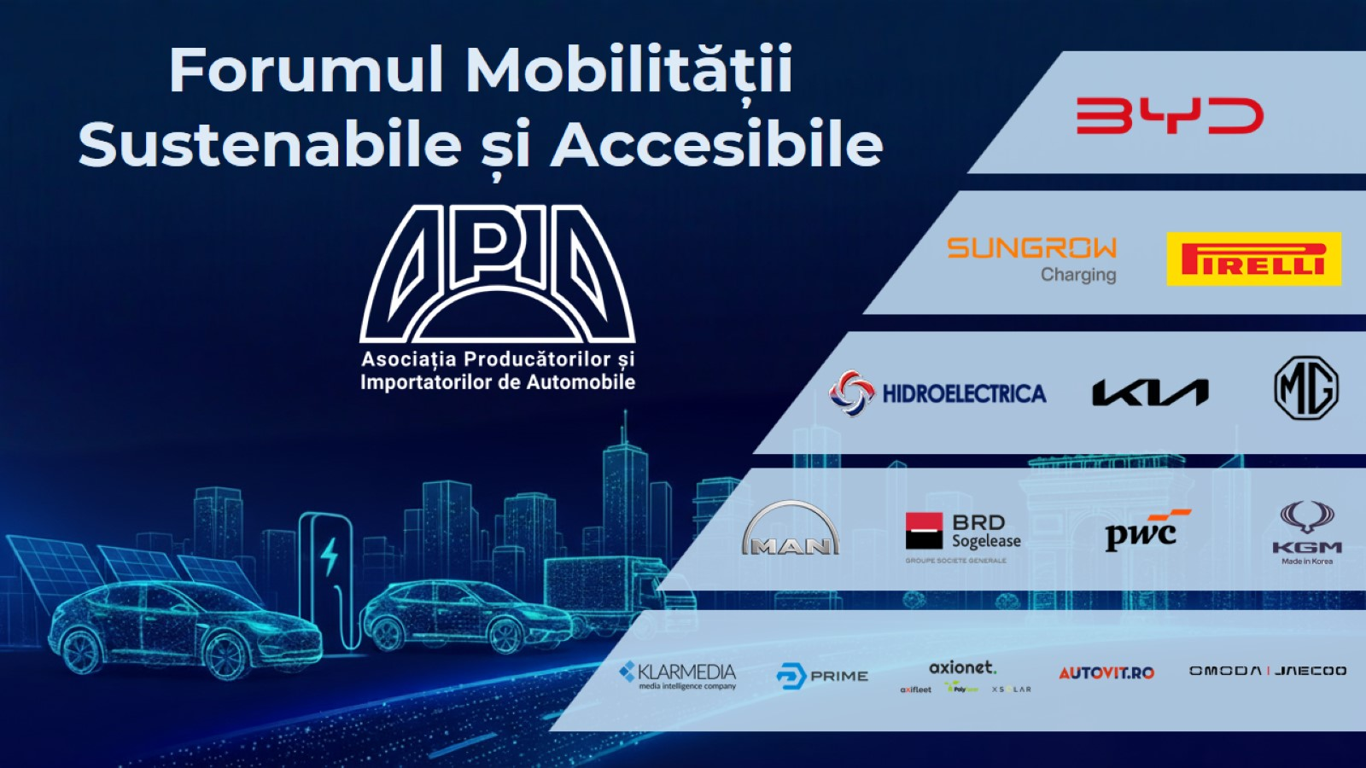

Slide 2


Slide 3
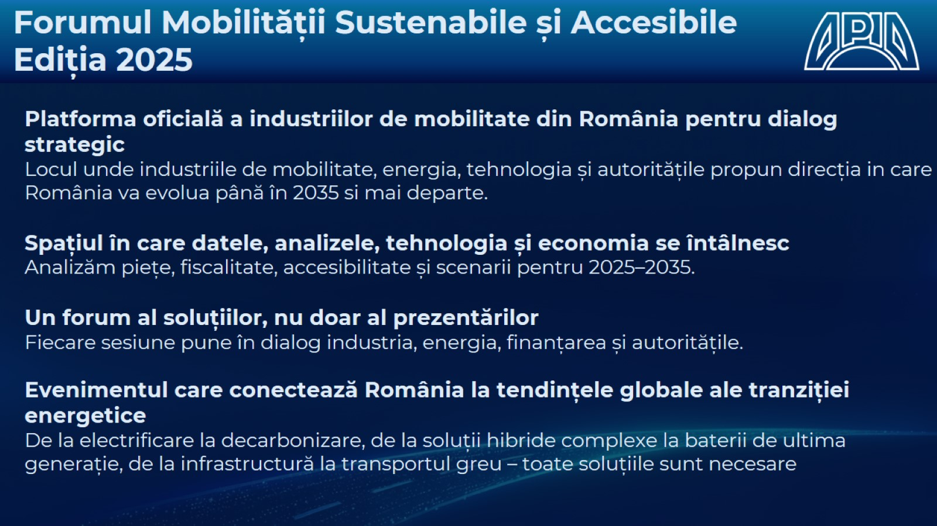

Slide 4
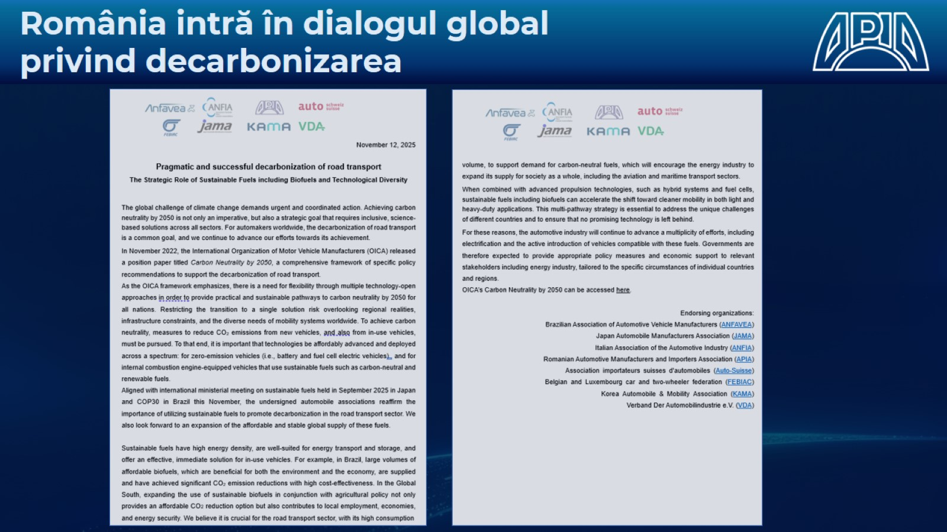

Slide 5
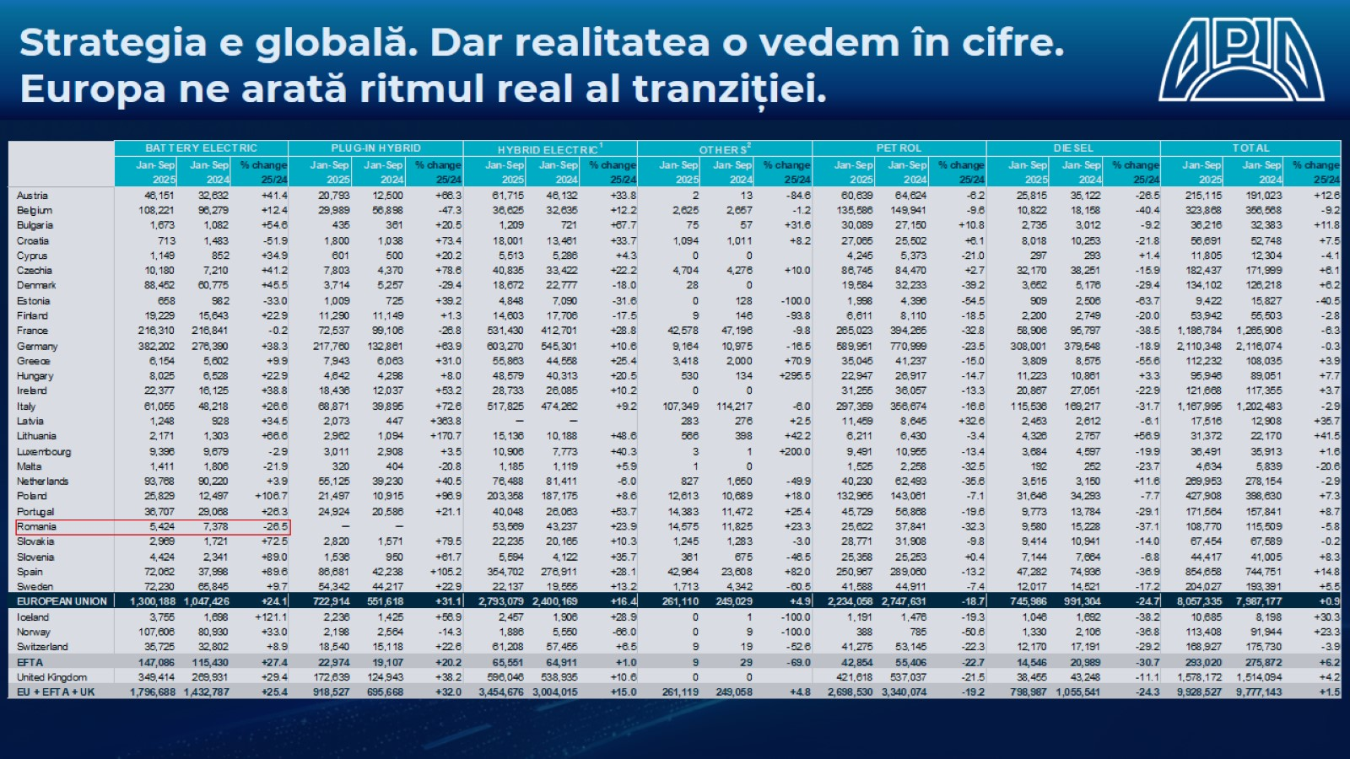

Slide 6
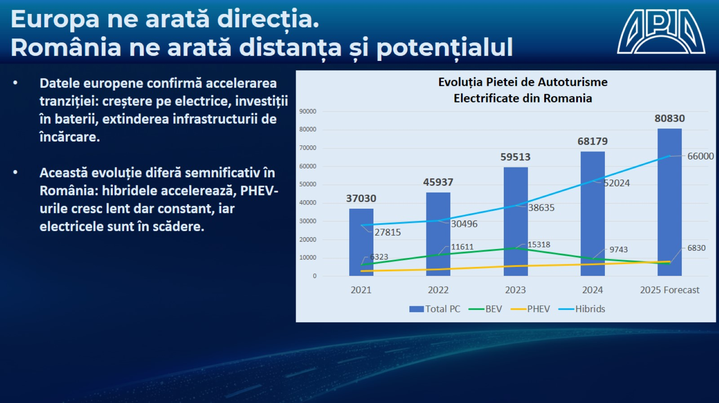

Slide 7
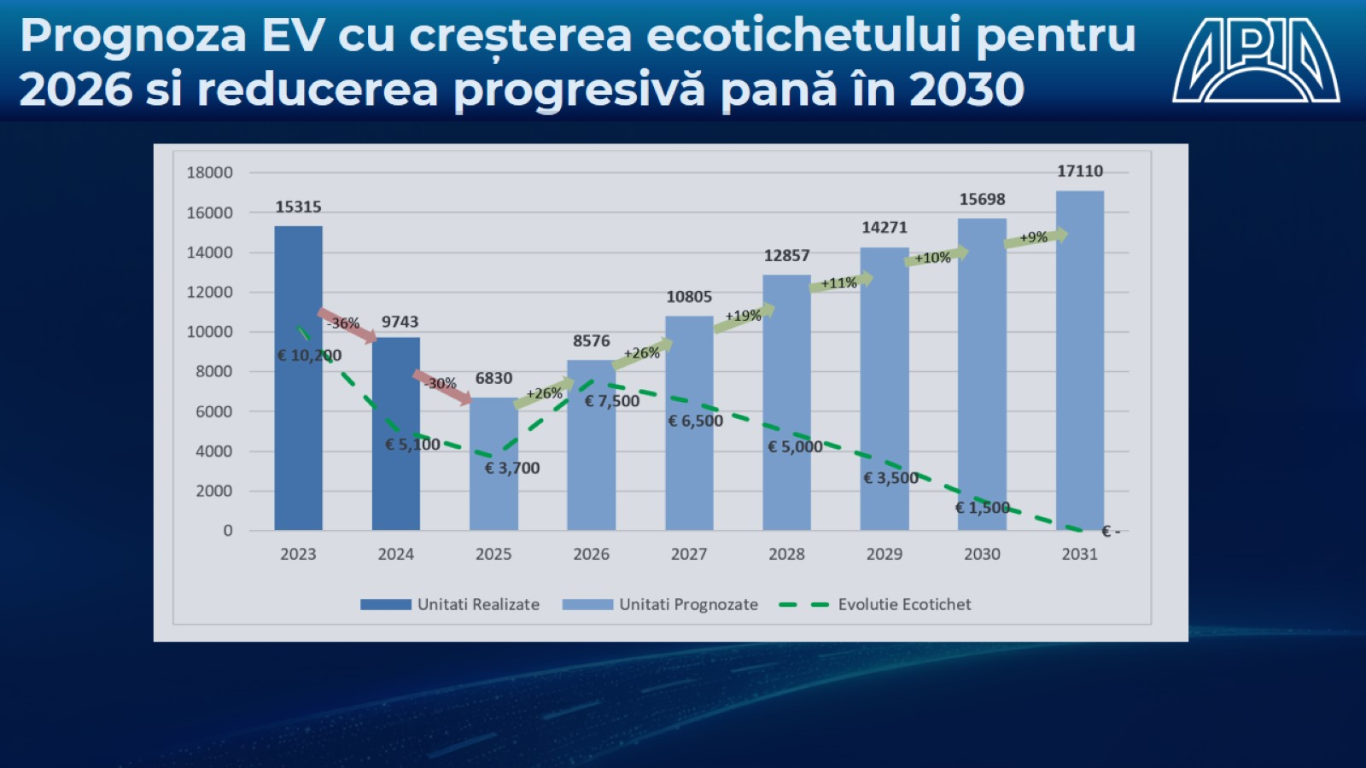

Slide 8
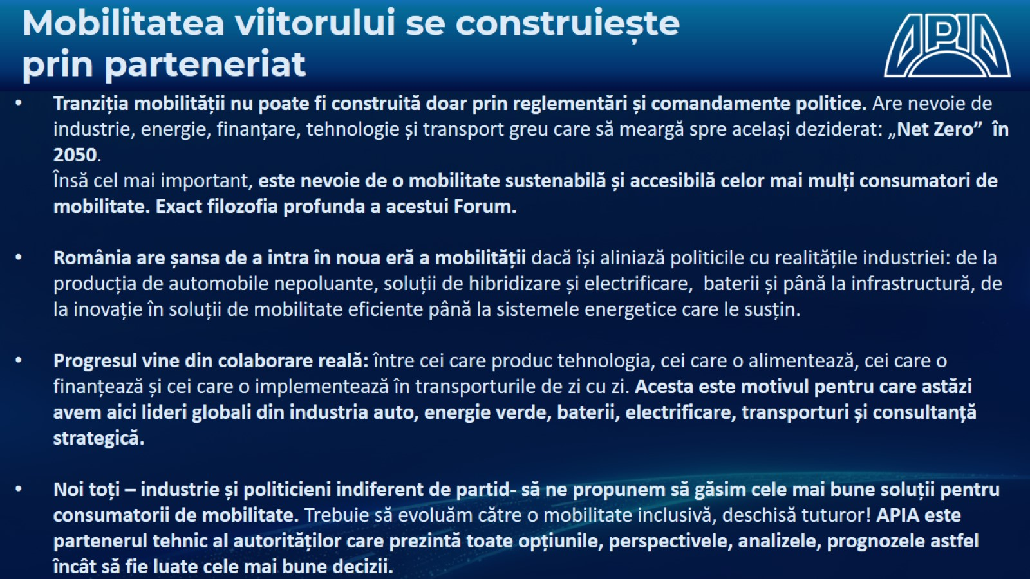

Slide 9
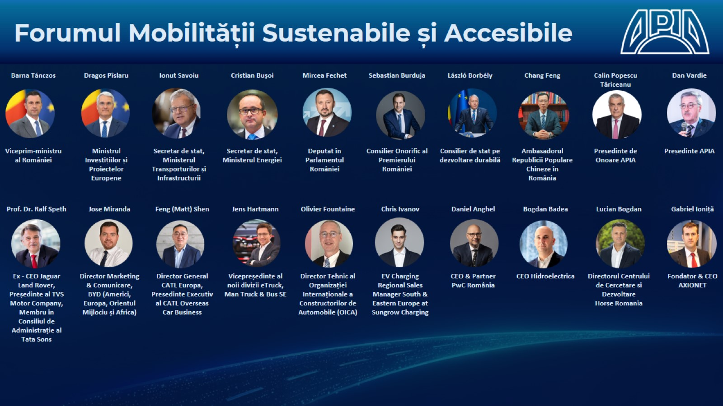

Slide 10
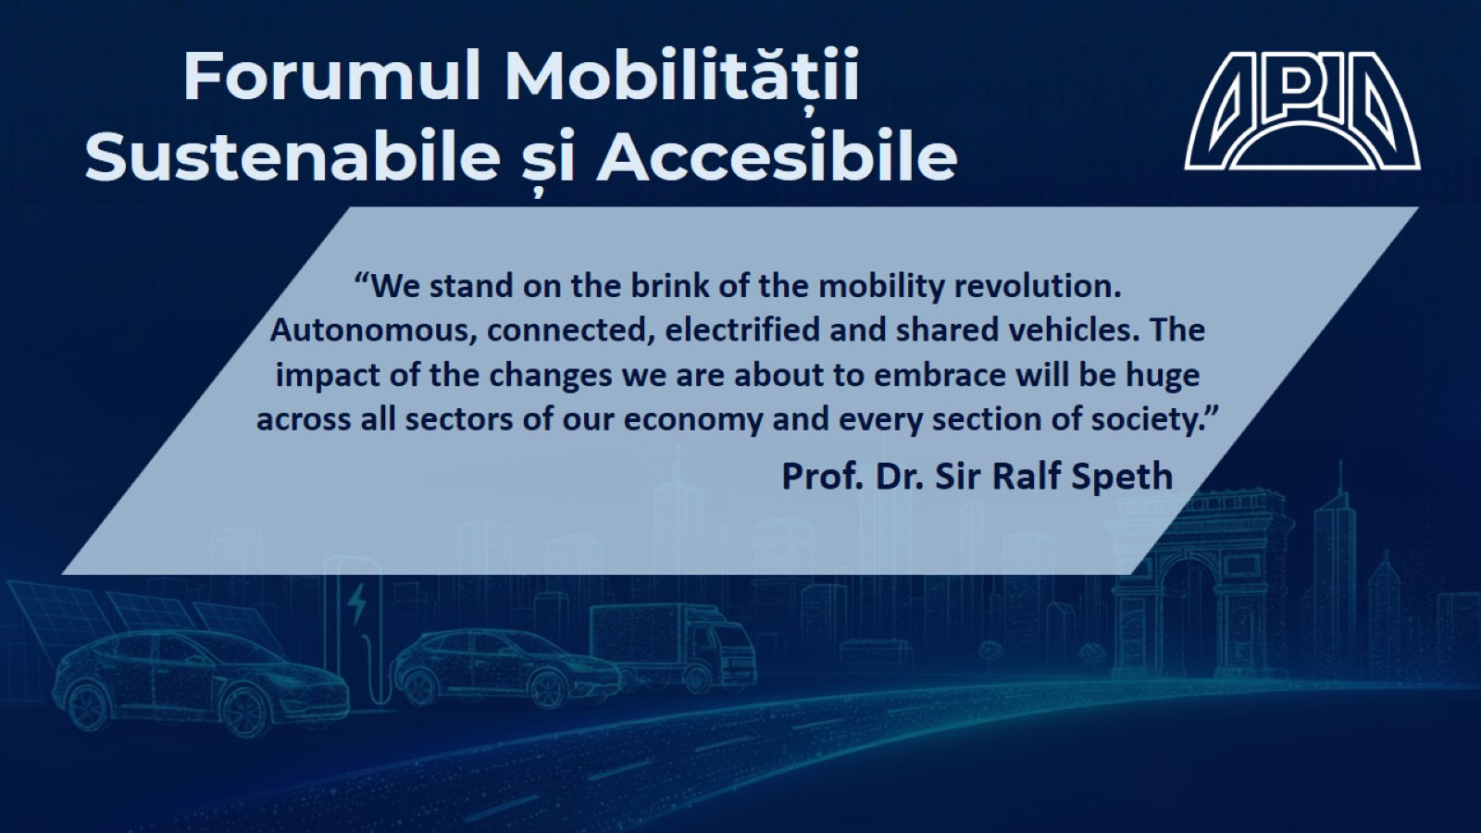

Slide 12


Slide 14


Slide 15
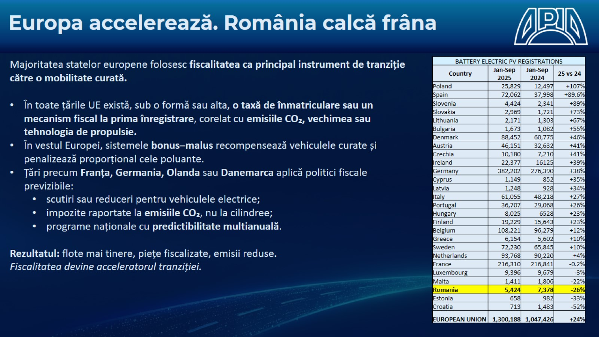

Slide 16
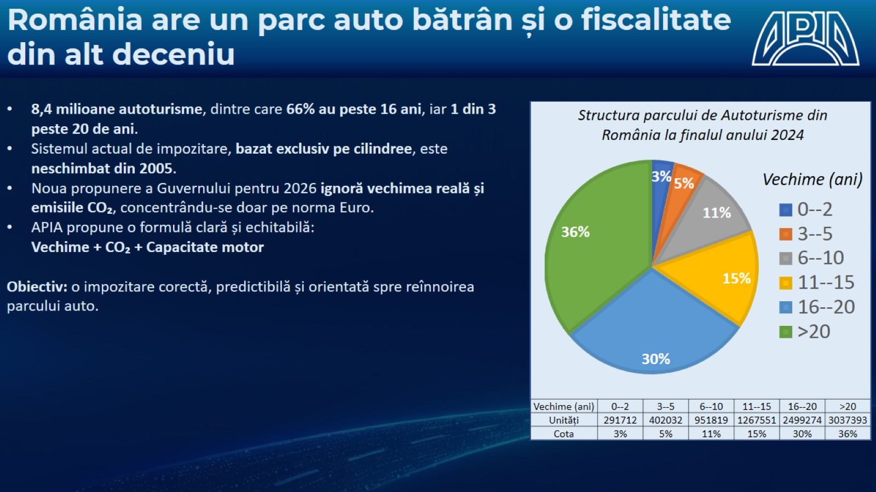

Slide 17
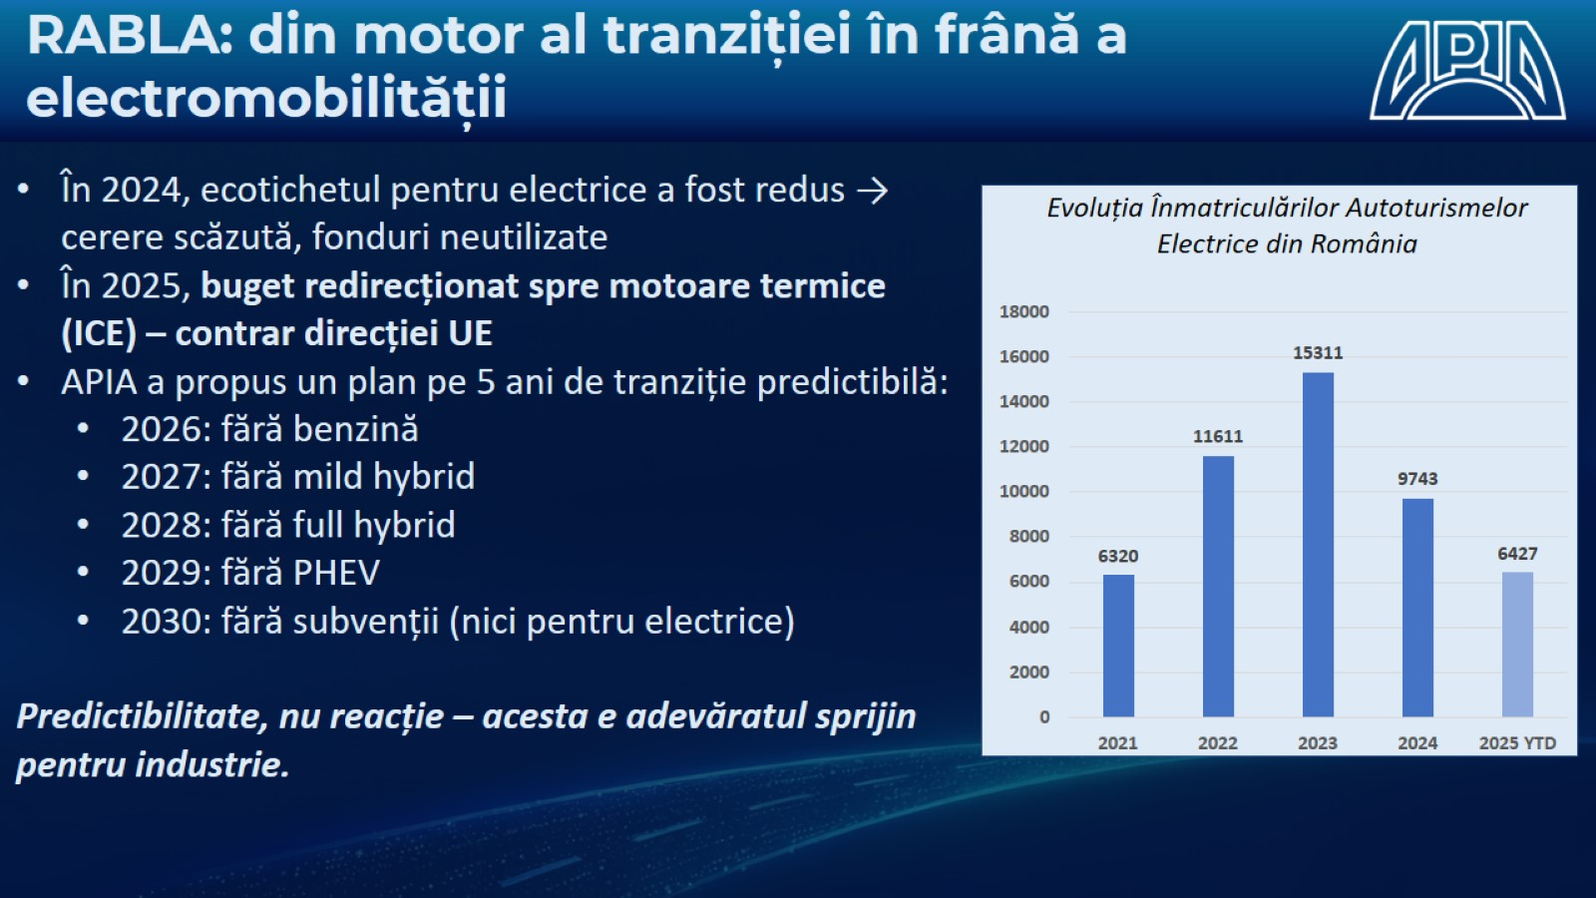

Slide 18
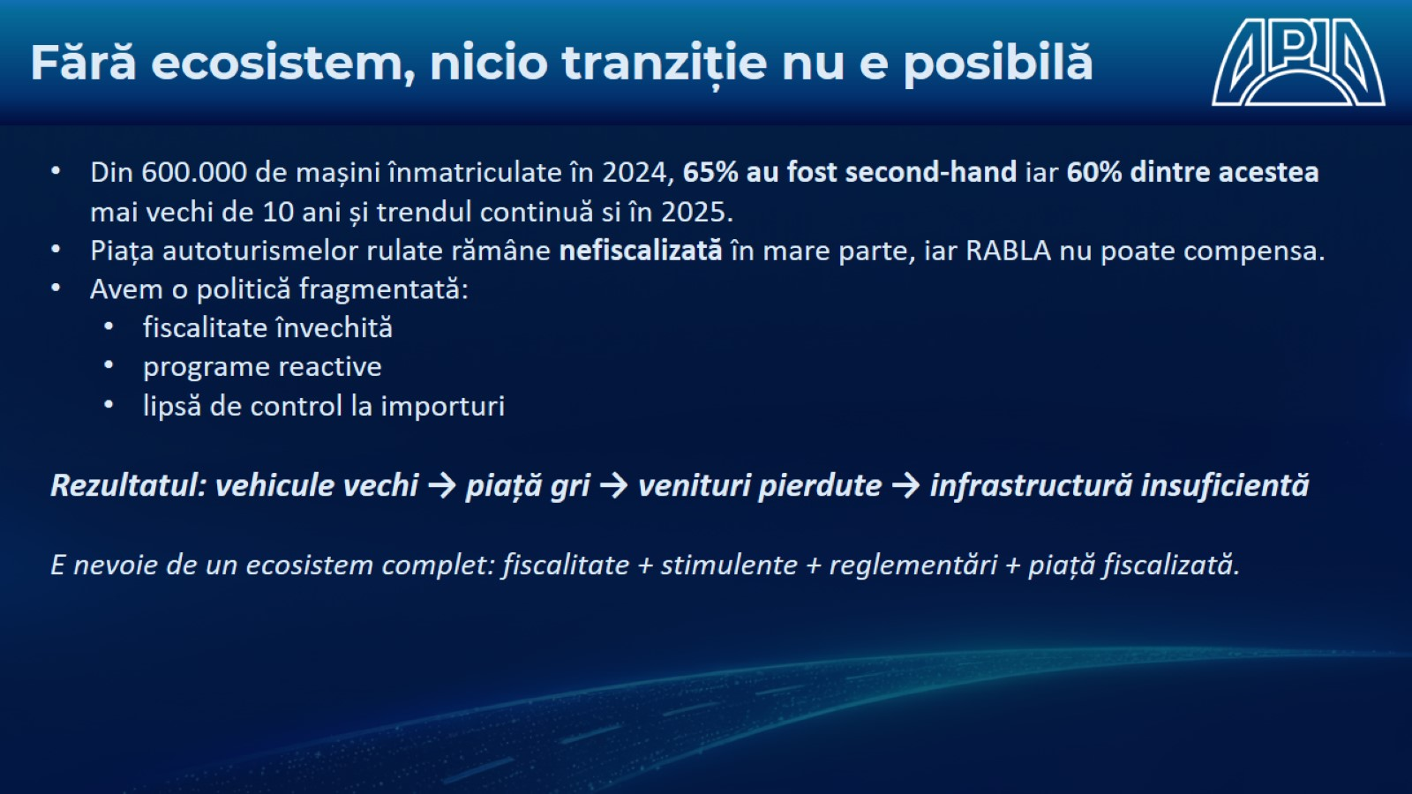

Slide 19
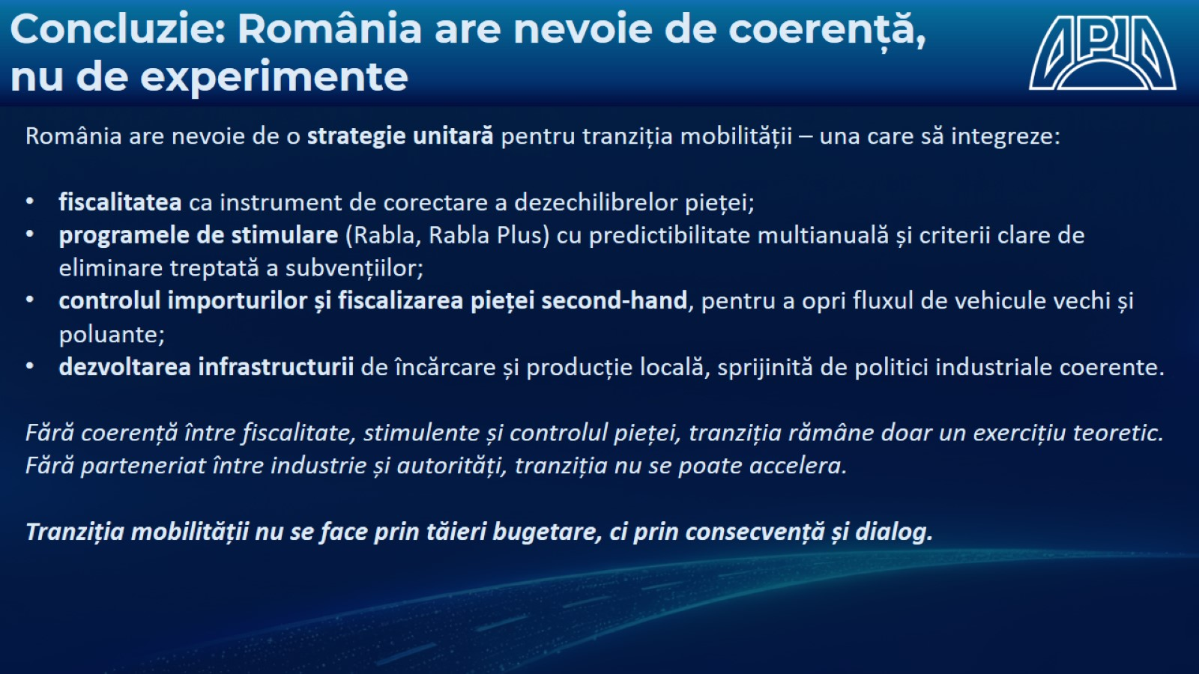

Slide 21


Slide 22
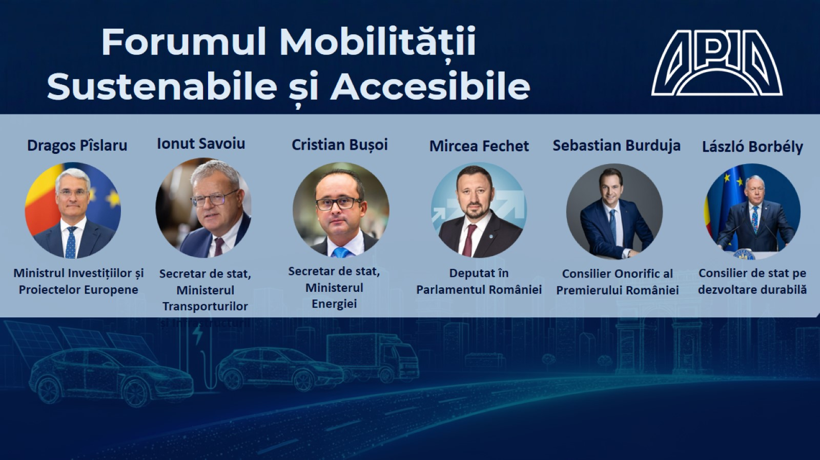

Slide 24


Slide 26


Slide 27

Main trends in the UN automobile regulatory activities

Slide 28
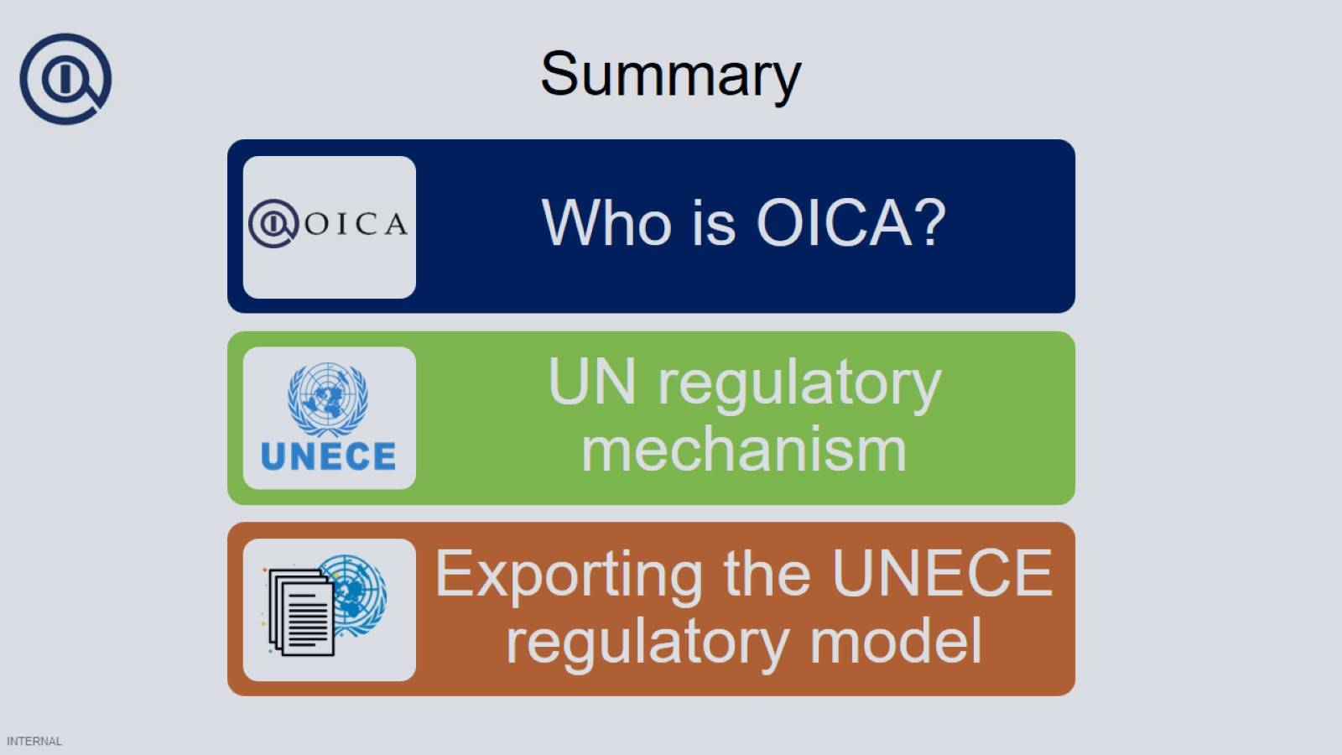
Summary

Slide 29
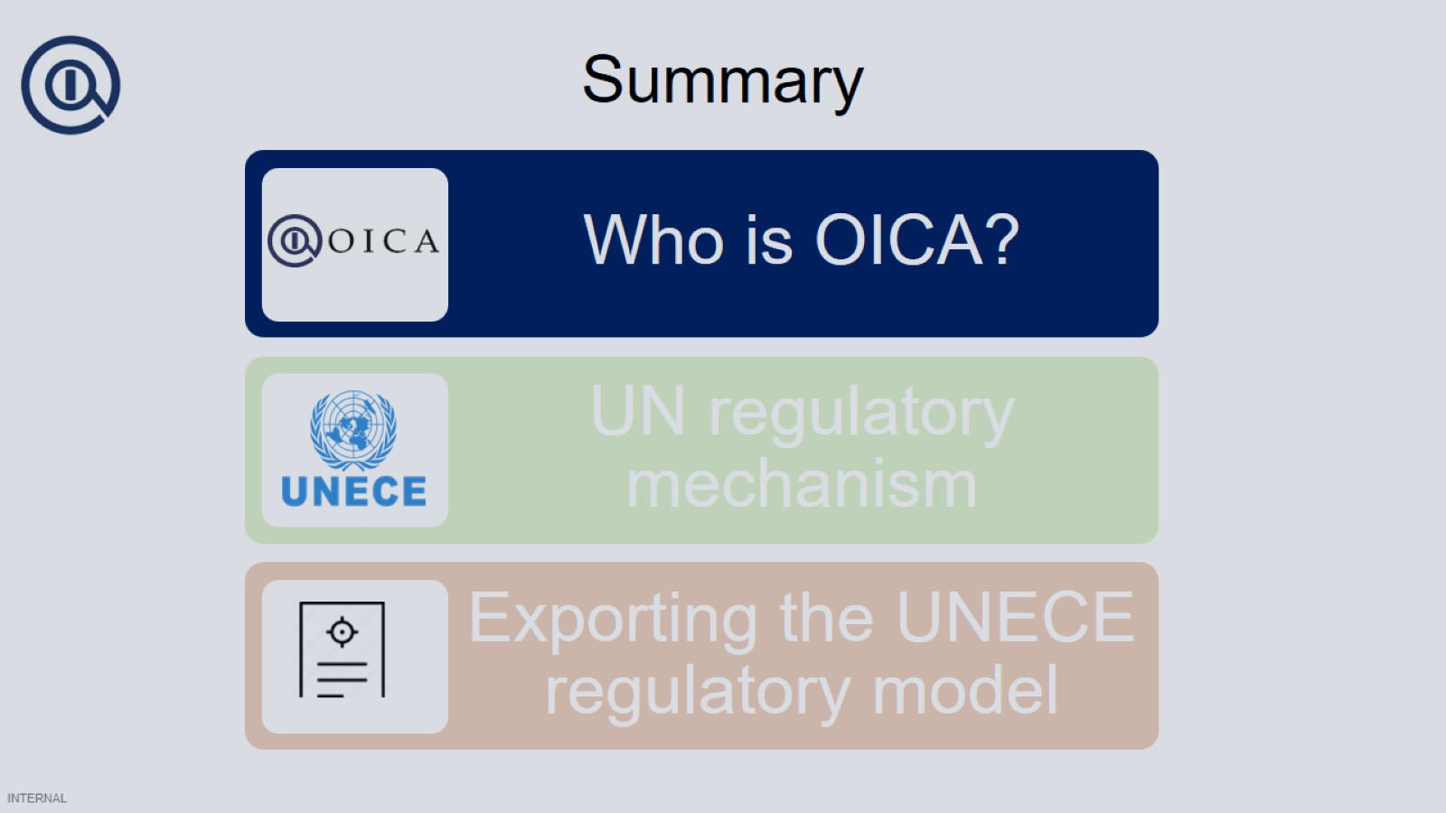
Summary

Slide 30
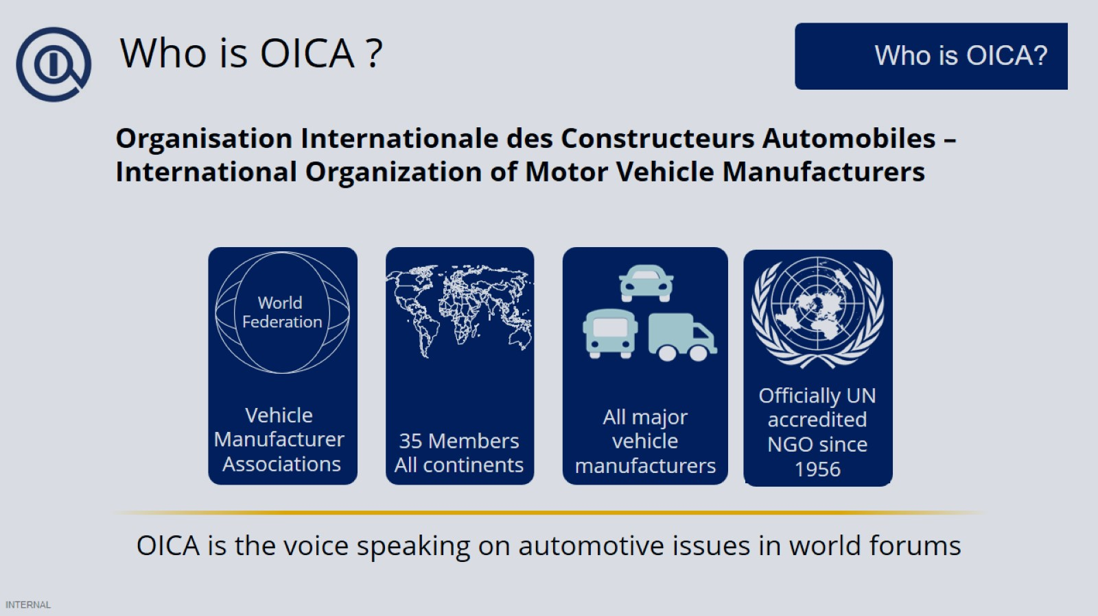
Who is OICA ?

Slide 31
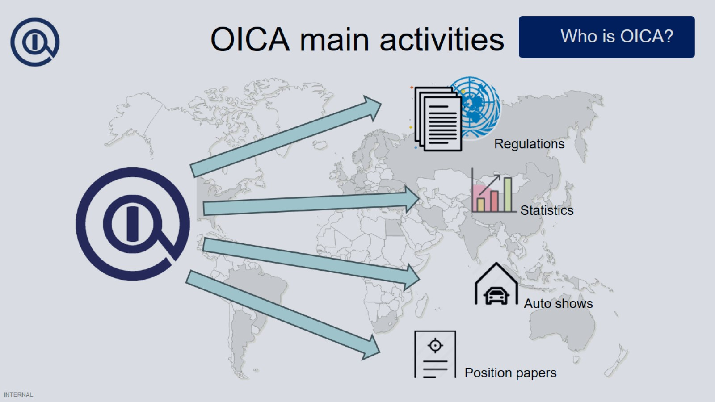
OICA main activities

Slide 32
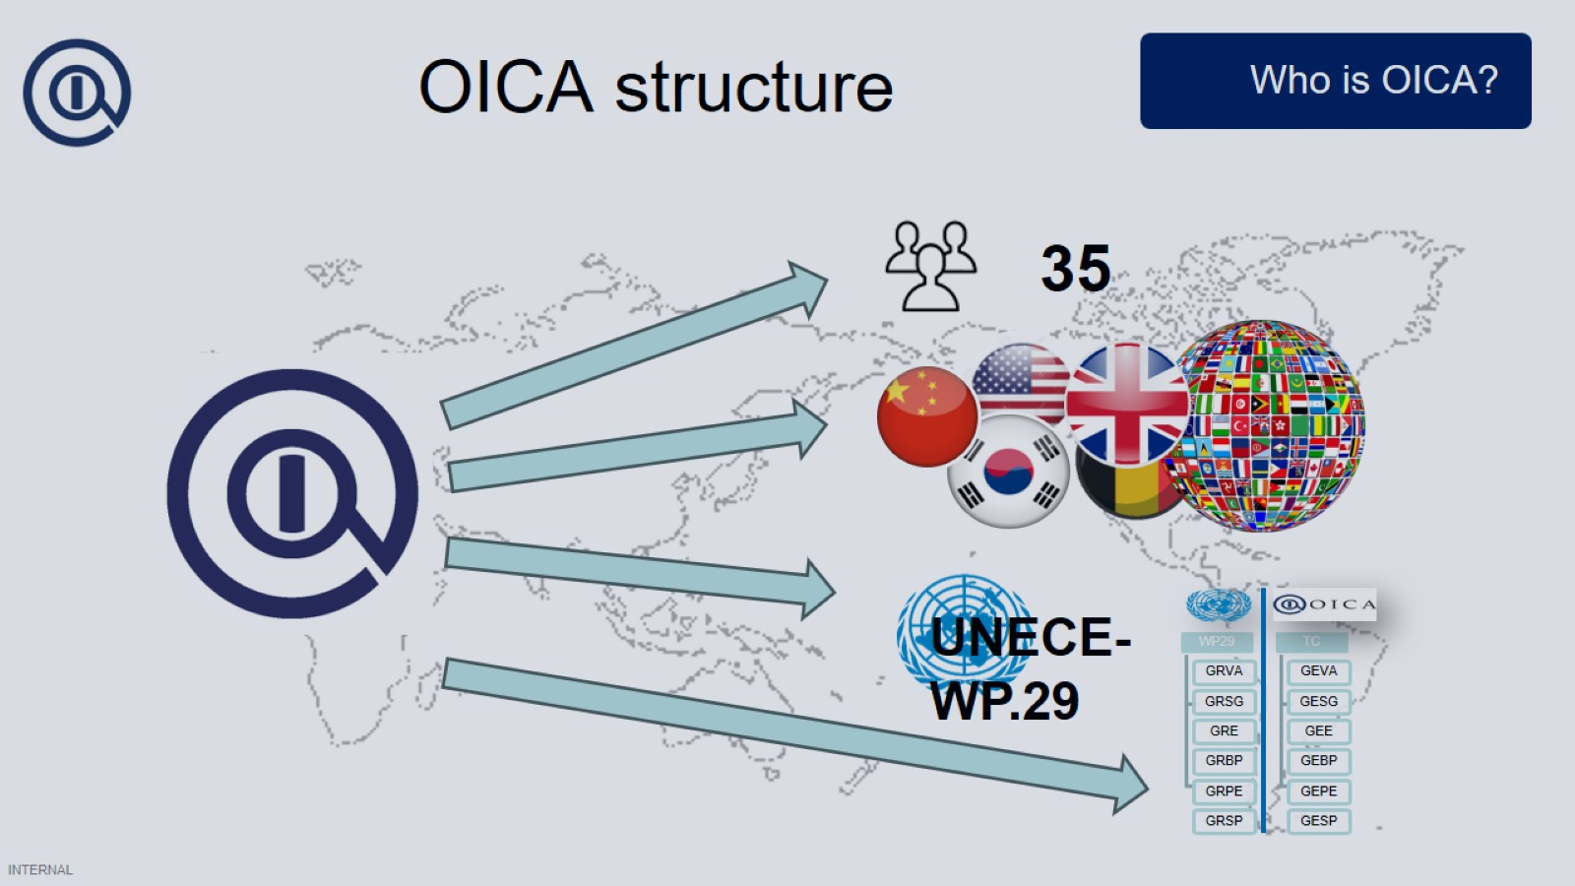

Slide 33
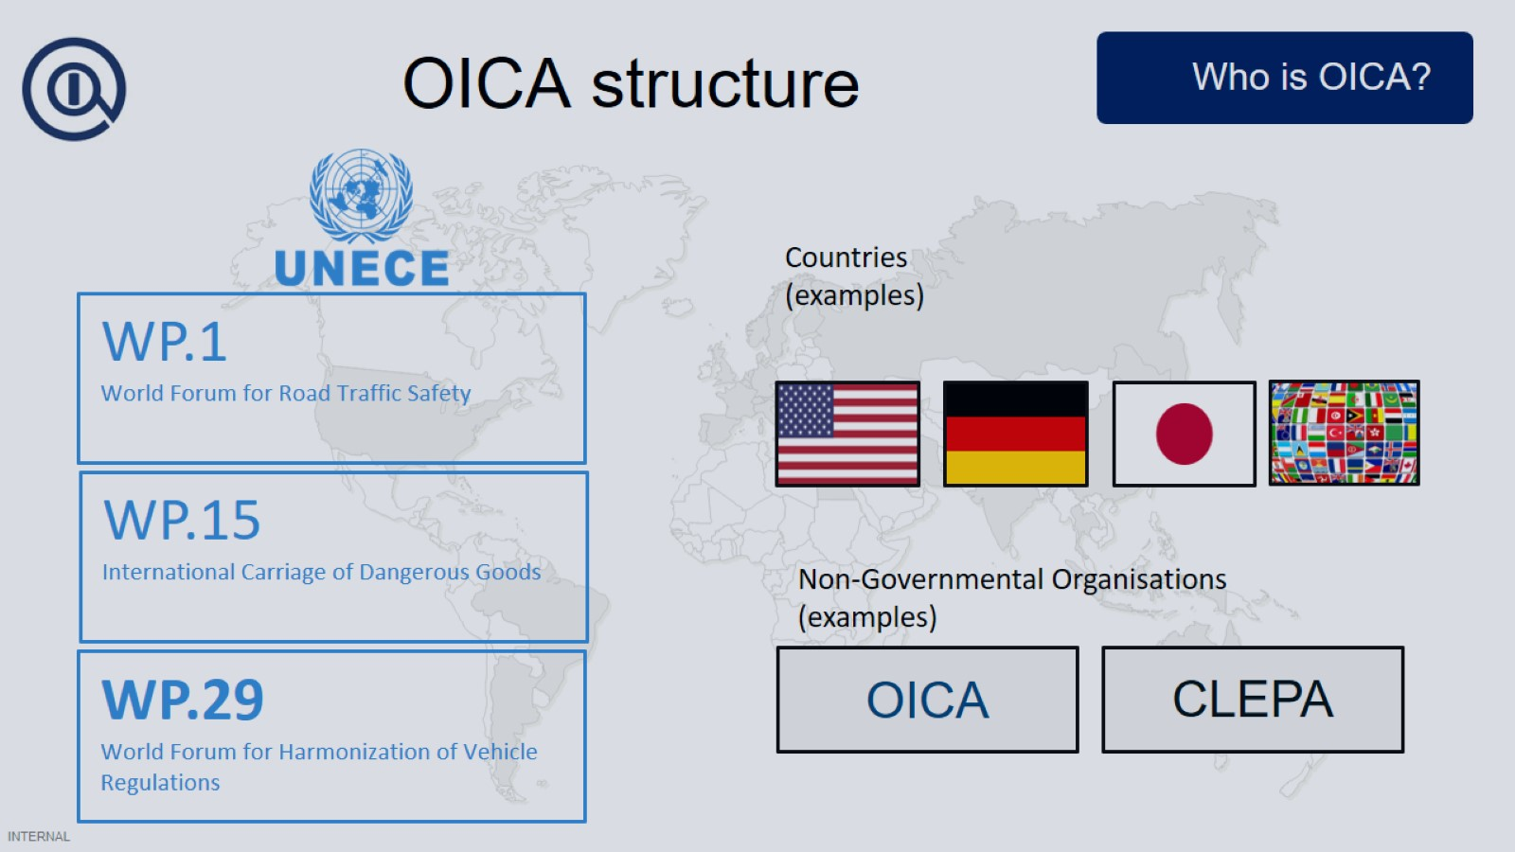

Slide 34
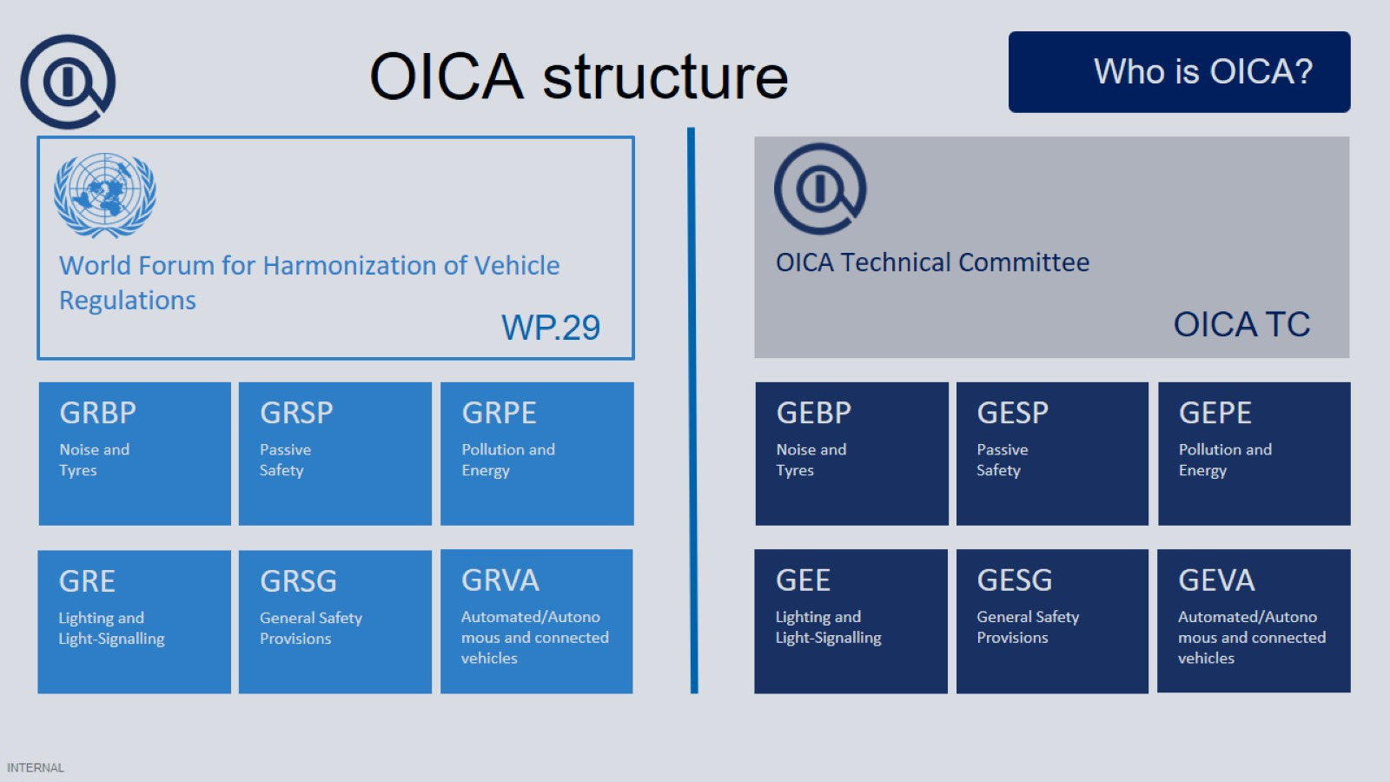

Slide 35
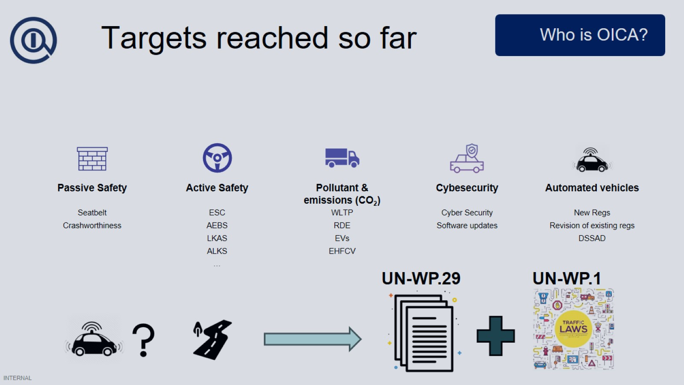
Targets reached so far

Slide 36
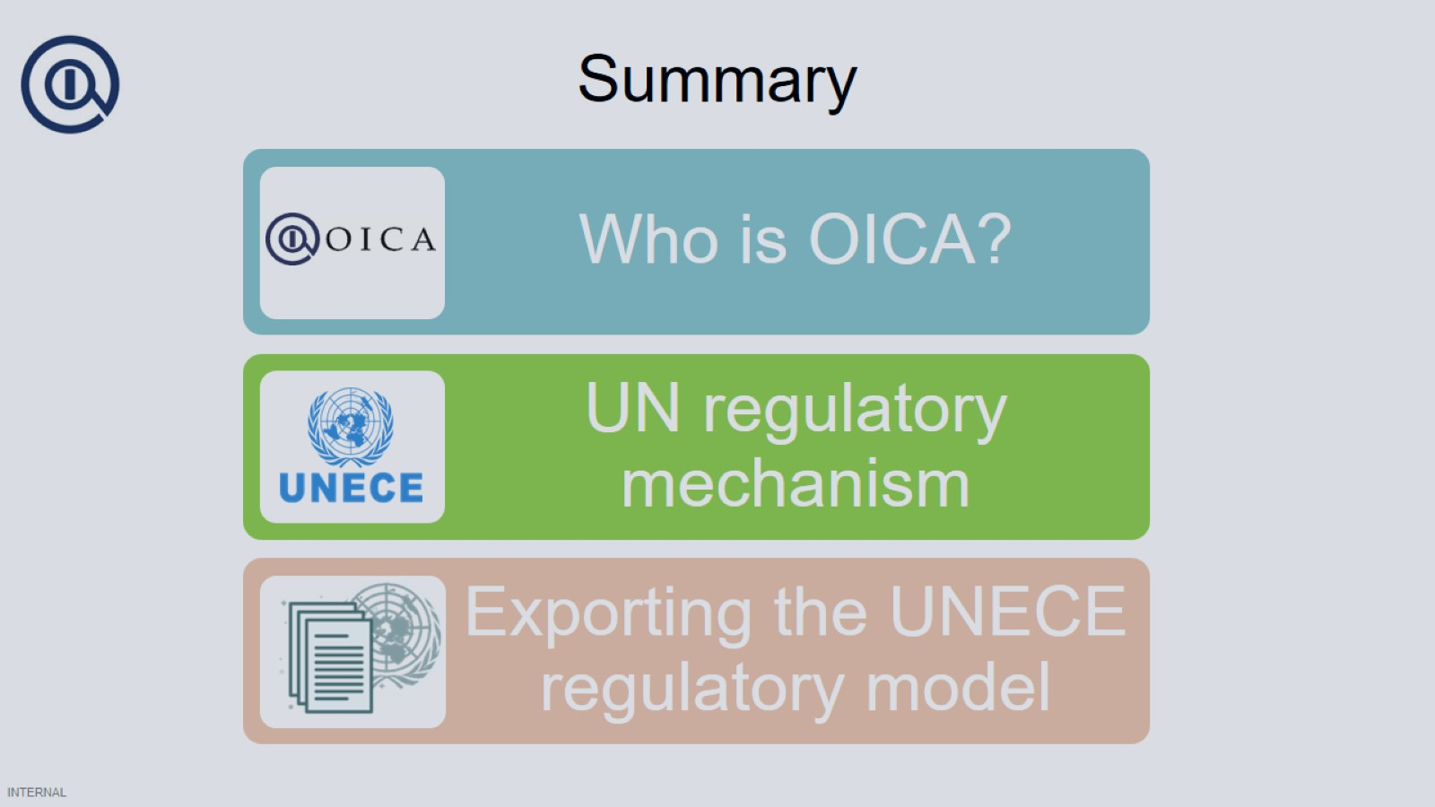
Summary

Slide 37
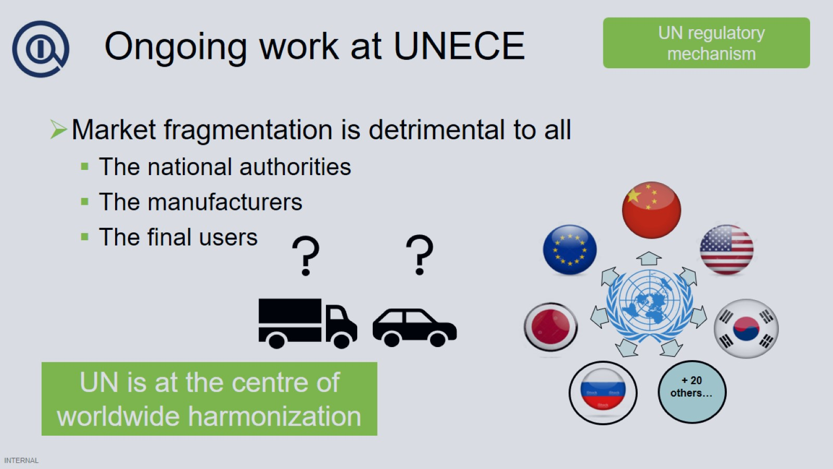
Ongoing work at UNECE

Slide 38
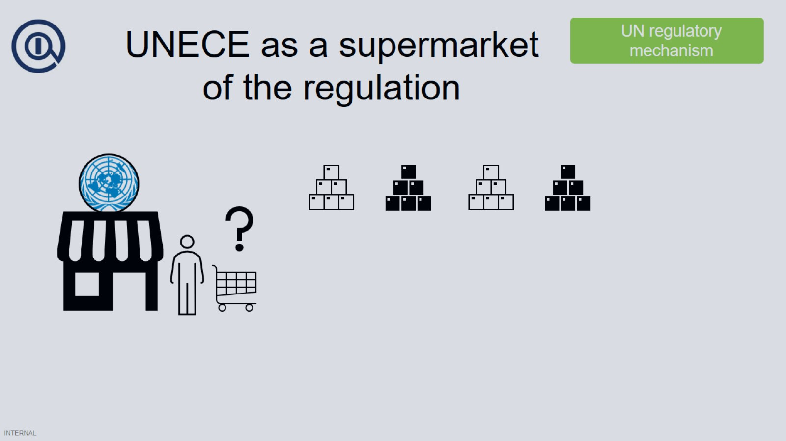
UNECE as a supermarket of the regulation

Slide 39


Slide 40
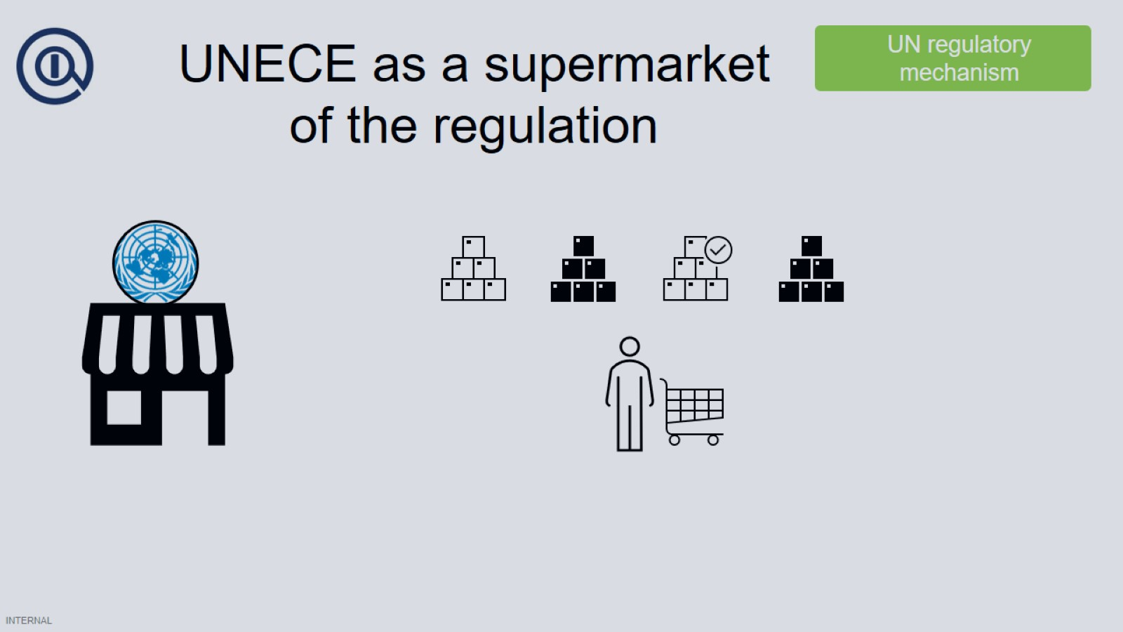
UNECE as a supermarket of the regulation

Slide 41

UNECE as a supermarket of the regulation

Slide 42
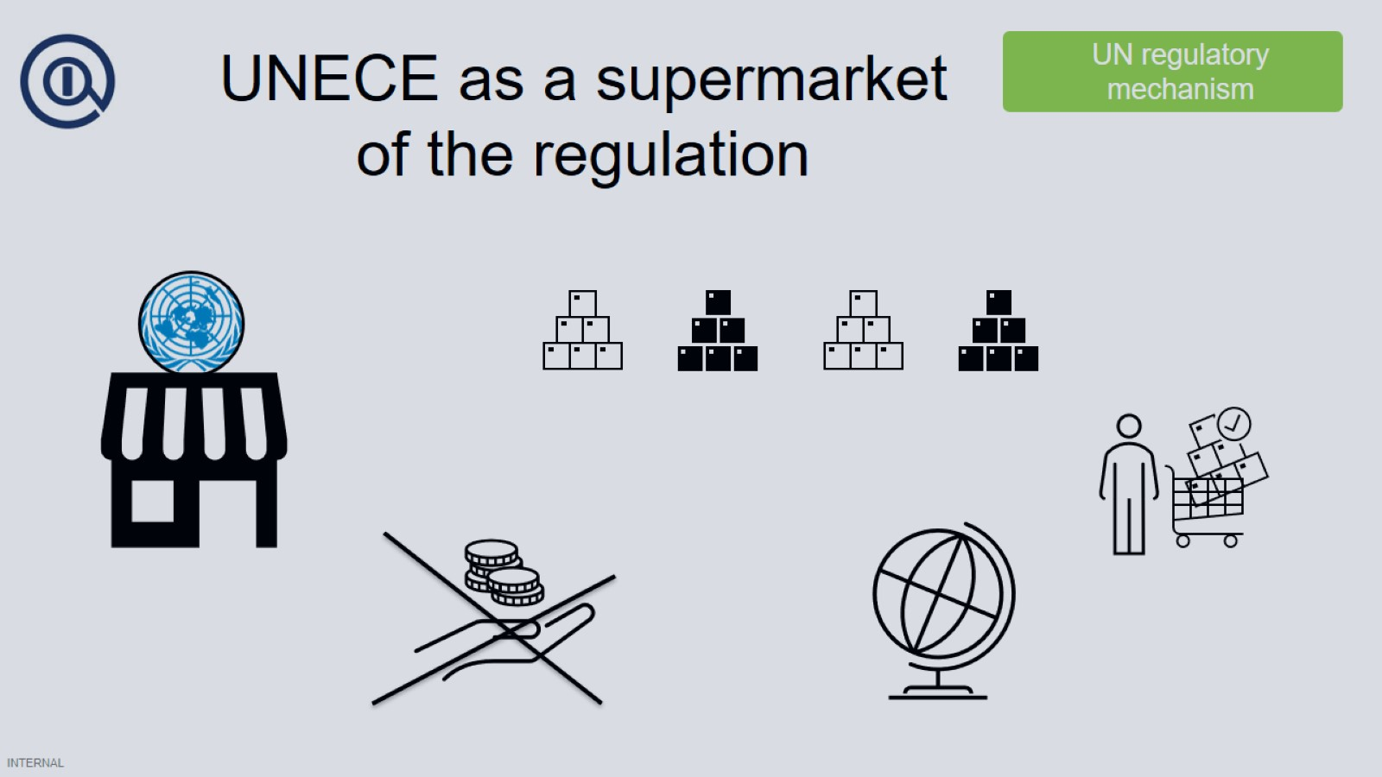
UNECE as a supermarket of the regulation

Slide 43
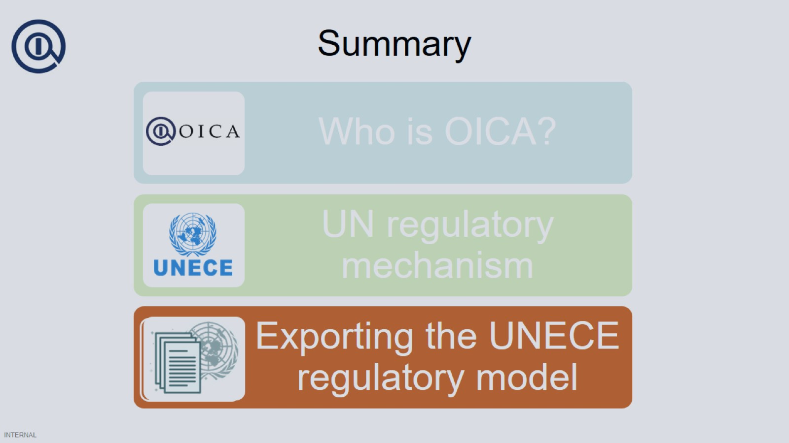
Summary

Slide 44
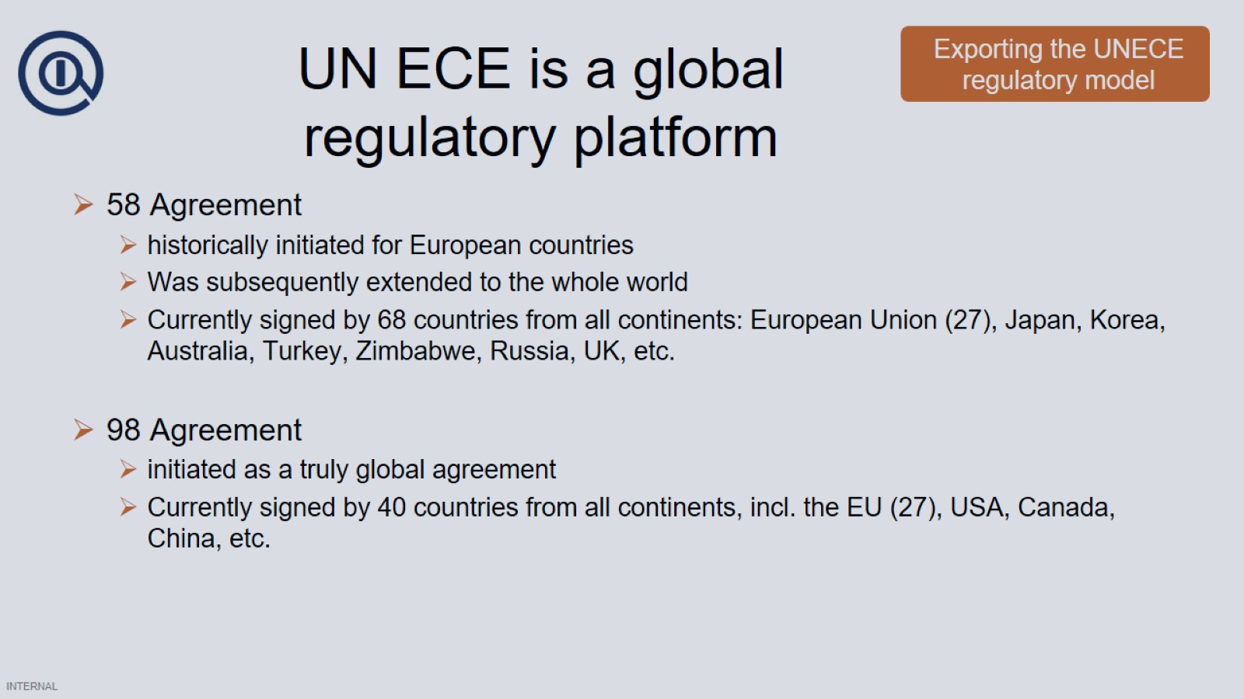
UN ECE is a global regulatory platform

Slide 45
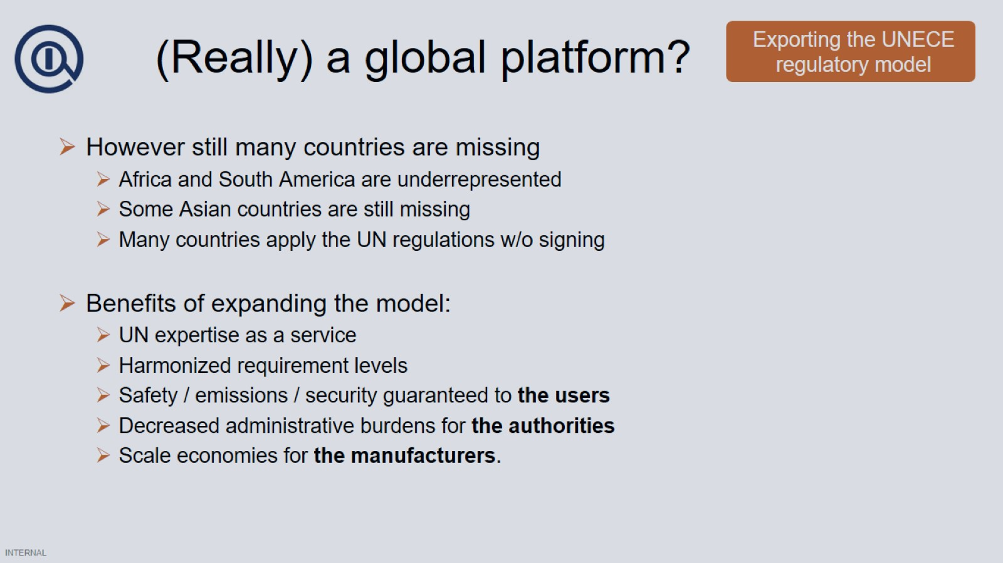
(Really) a global platform?

Slide 46
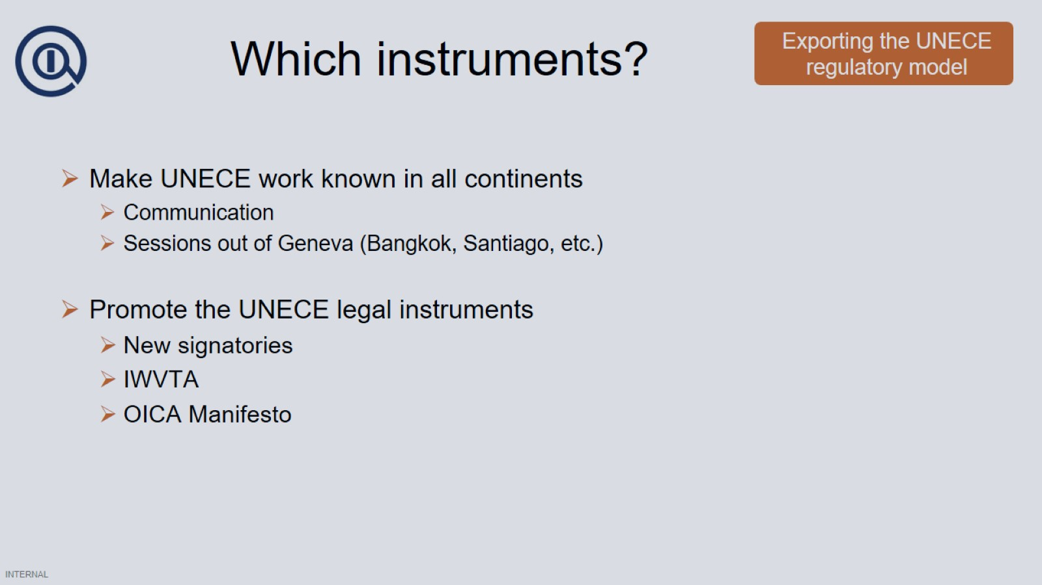
Which instruments?

Slide 47
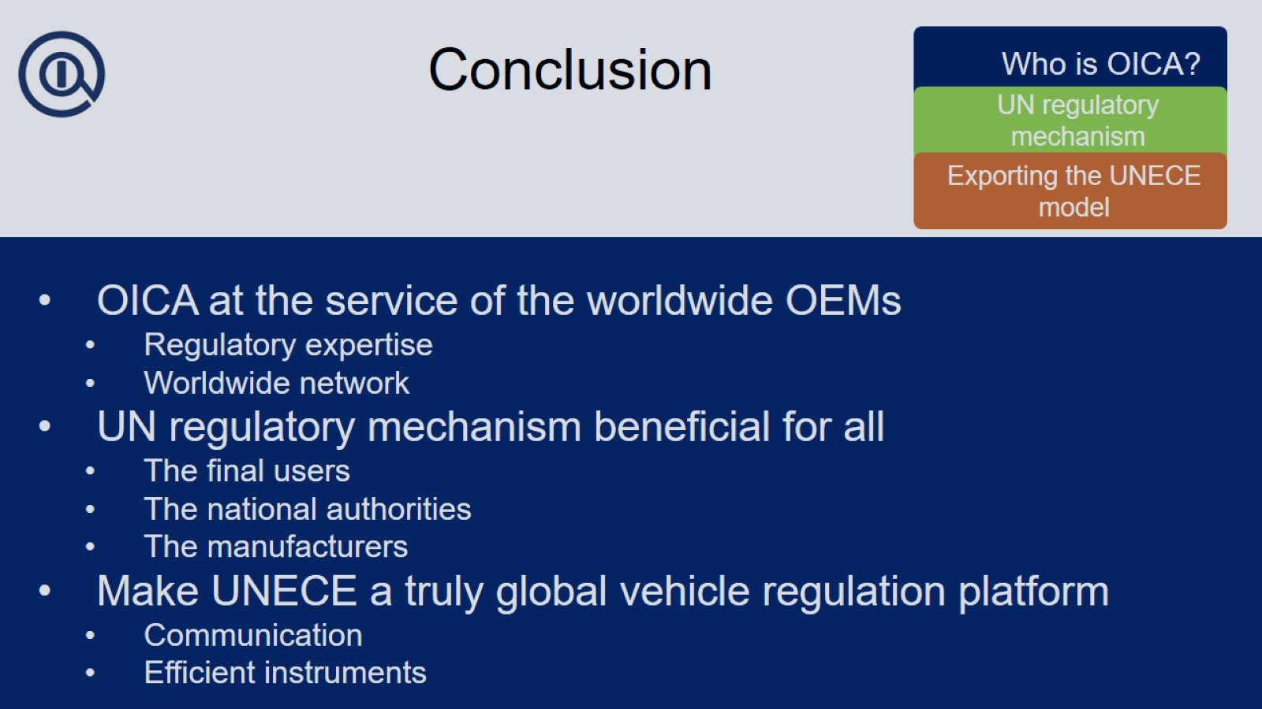
Conclusion

Slide 48


Slide 49
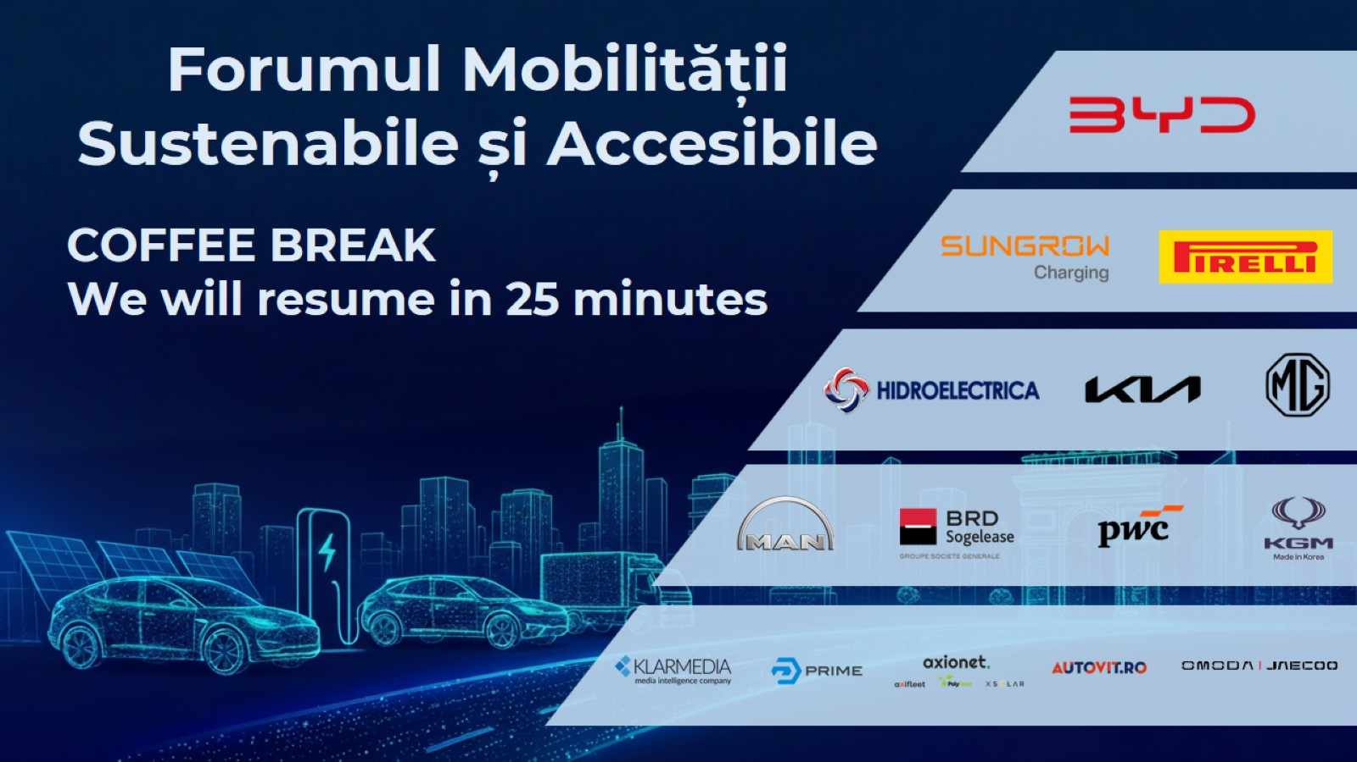

Slide 50


Slide 51


Slide 52


Slide 55


Slide 56


Slide 57
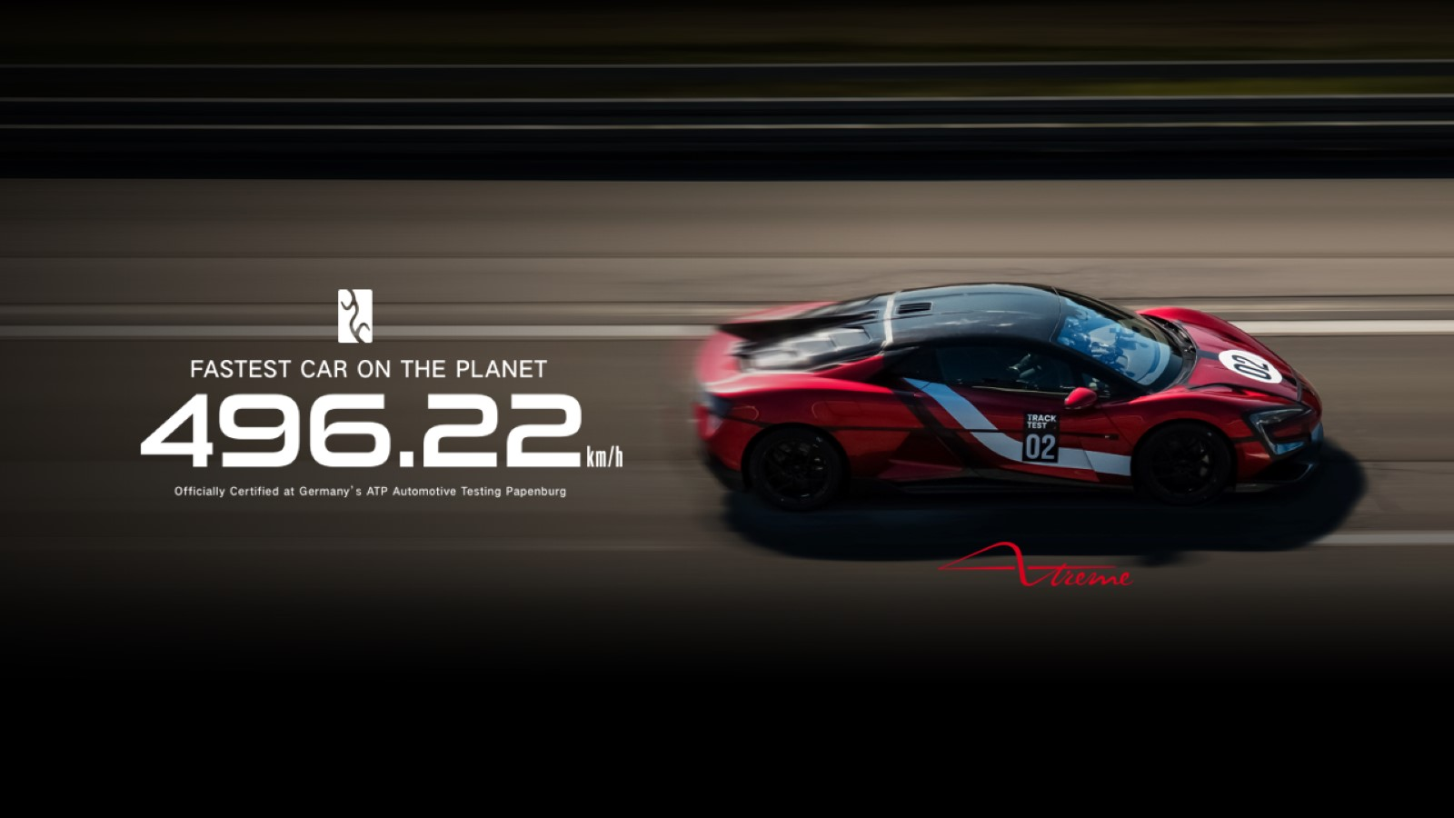

Slide 58
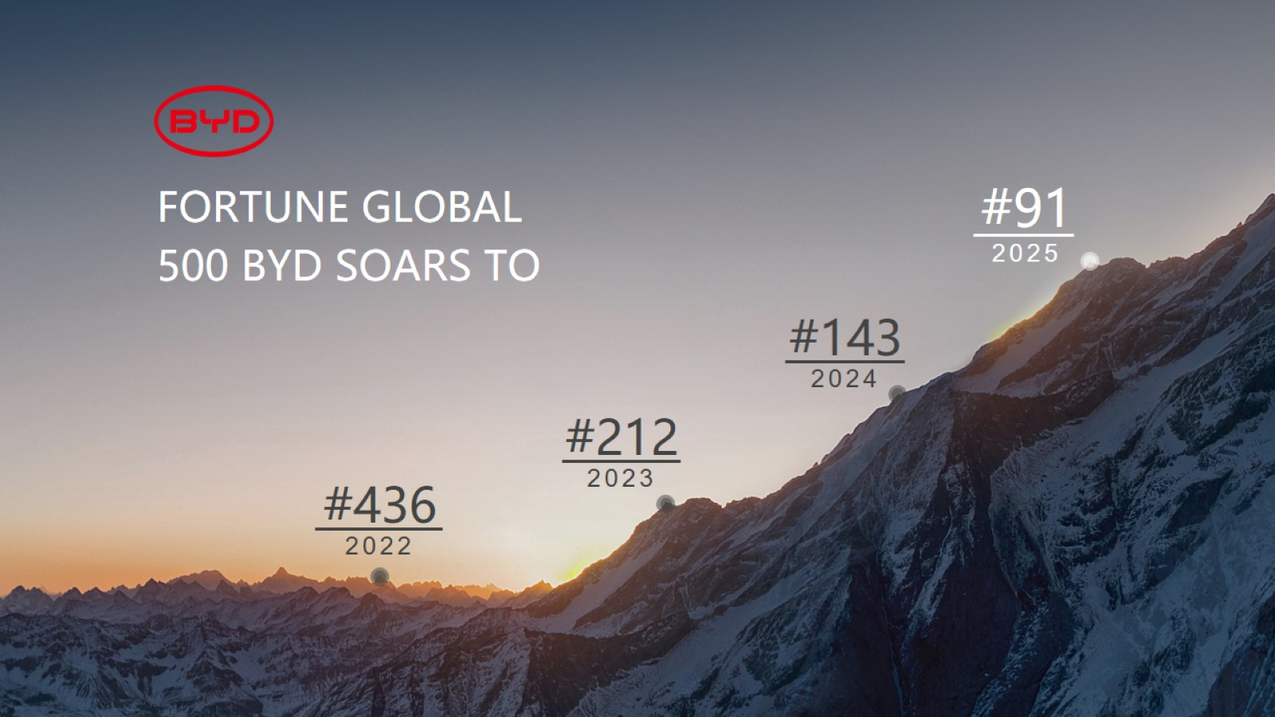

Slide 59
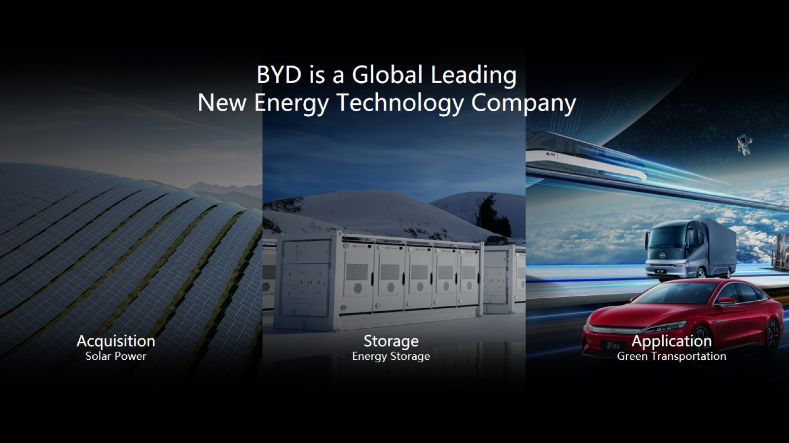

Slide 60
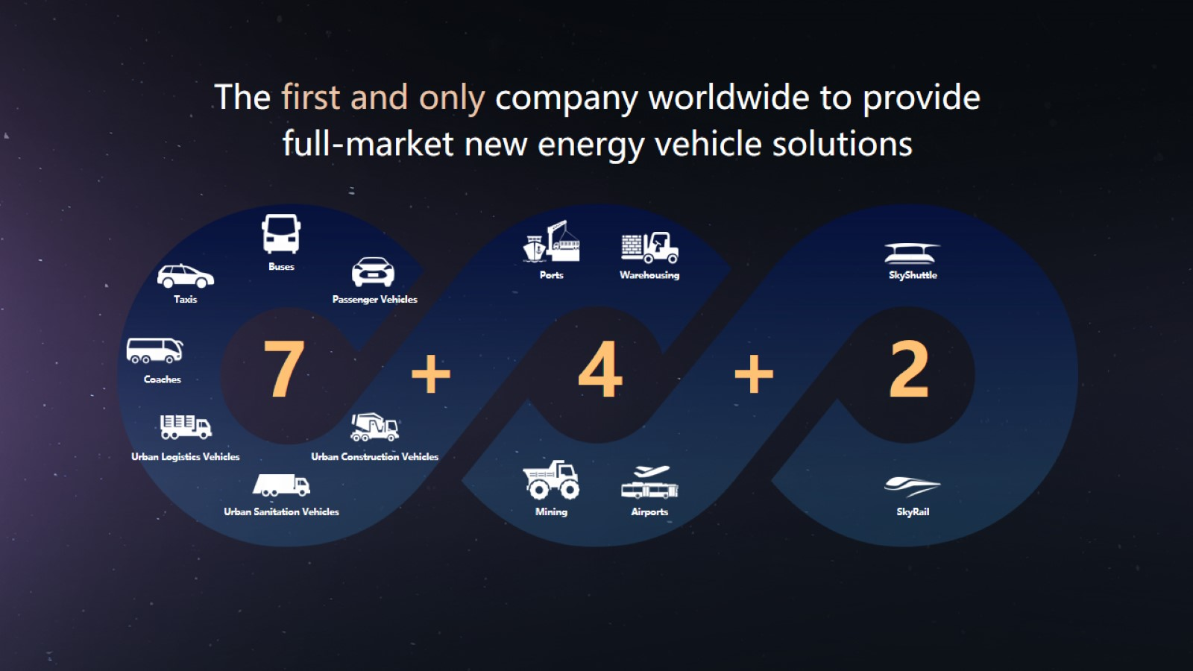

Slide 61
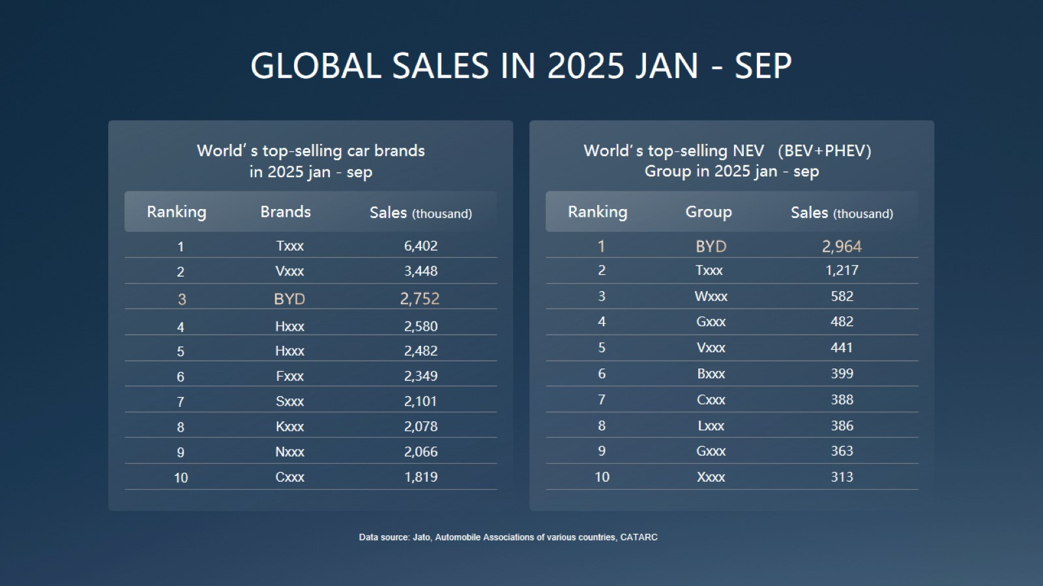

Slide 62


Slide 63
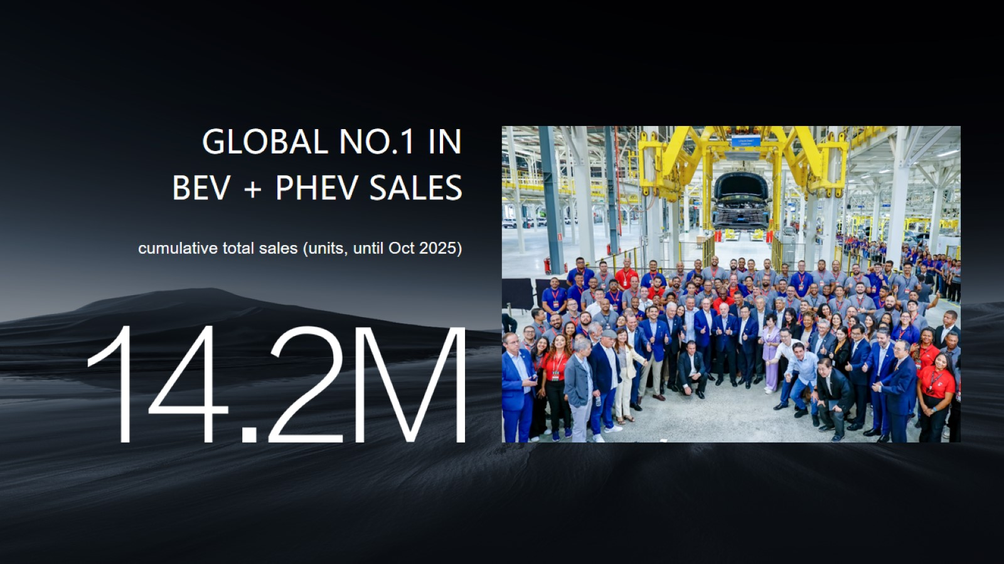

Slide 64
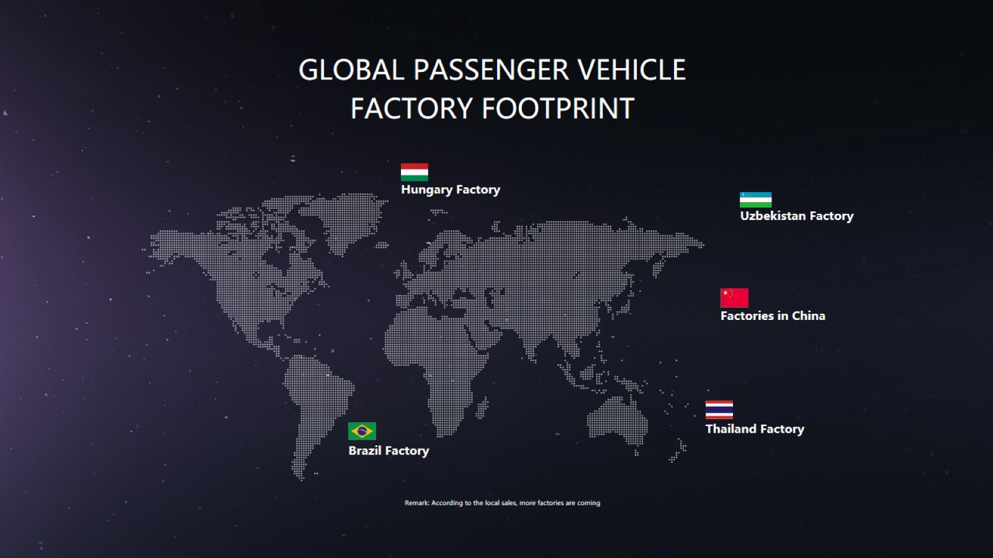

Slide 65
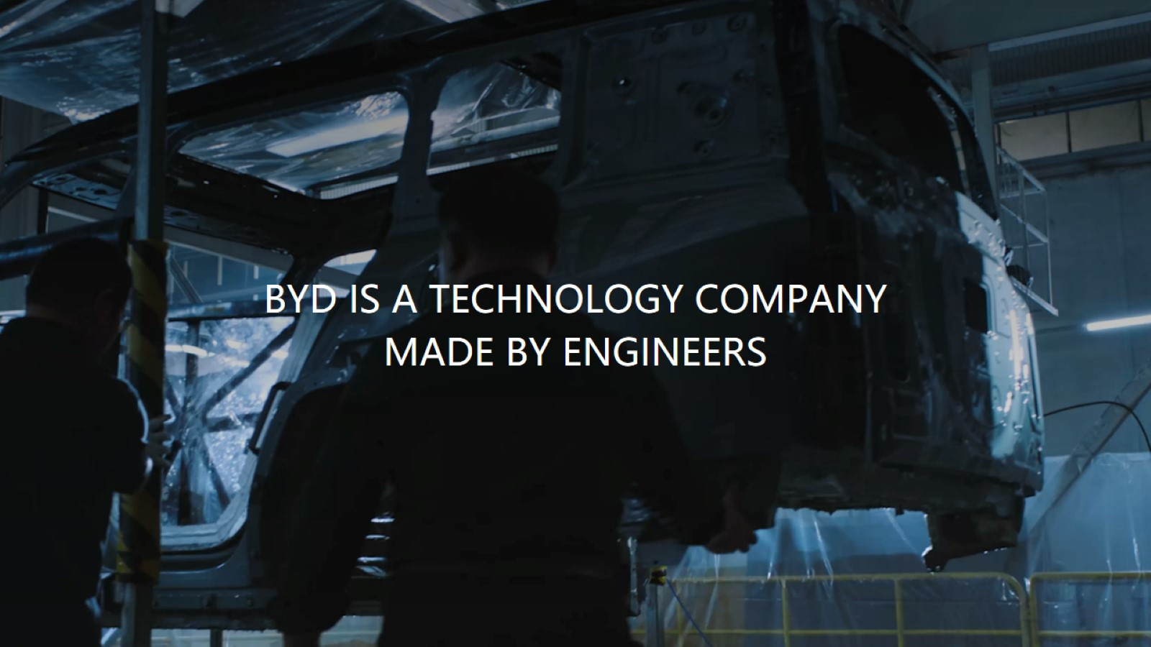

Slide 66
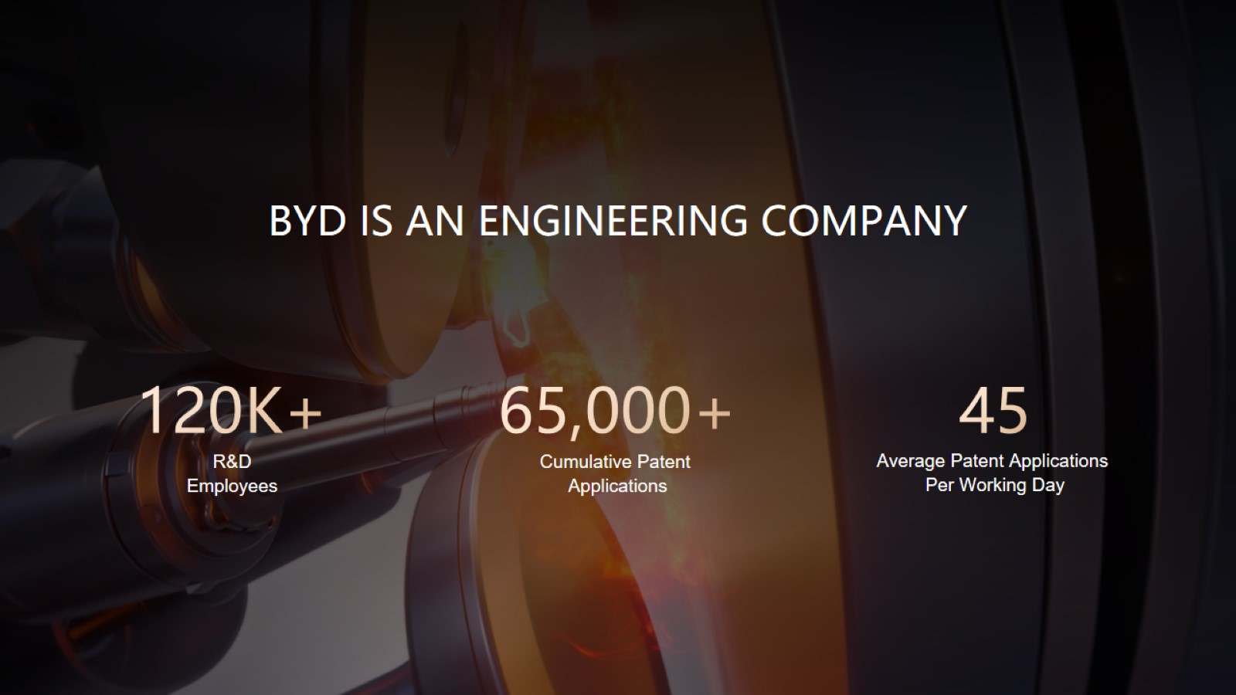

Slide 67
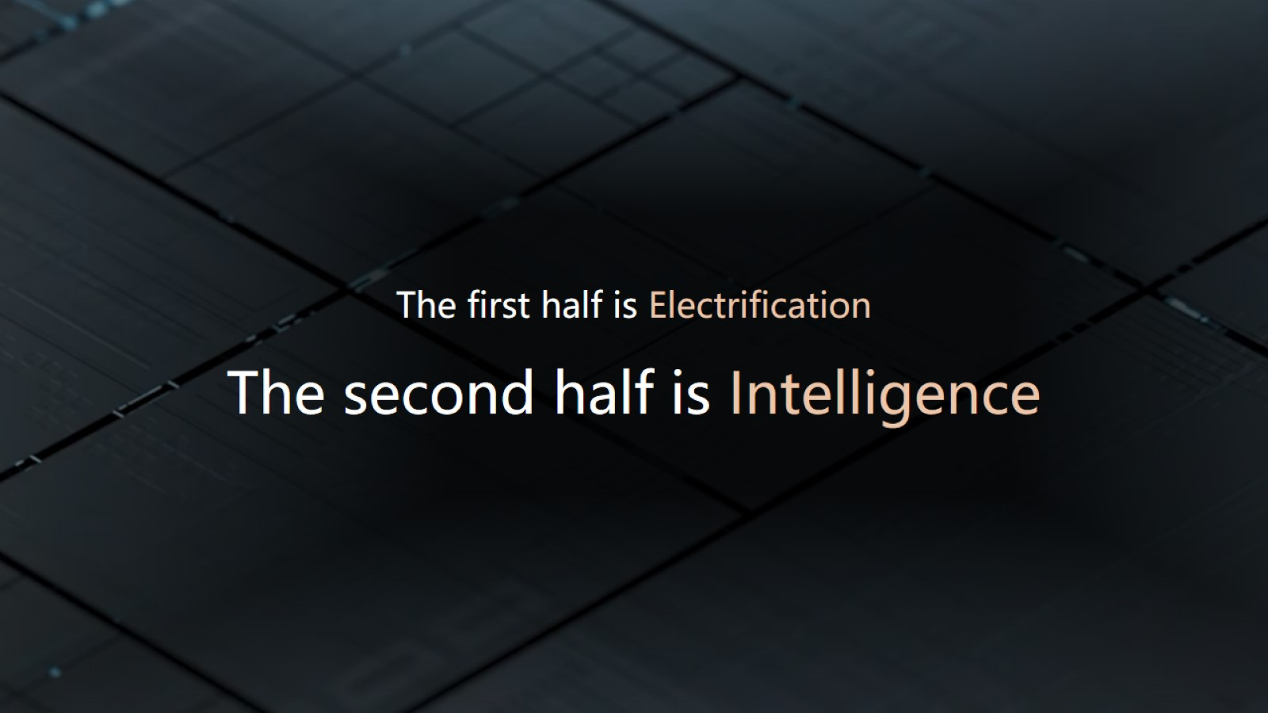

Slide 69
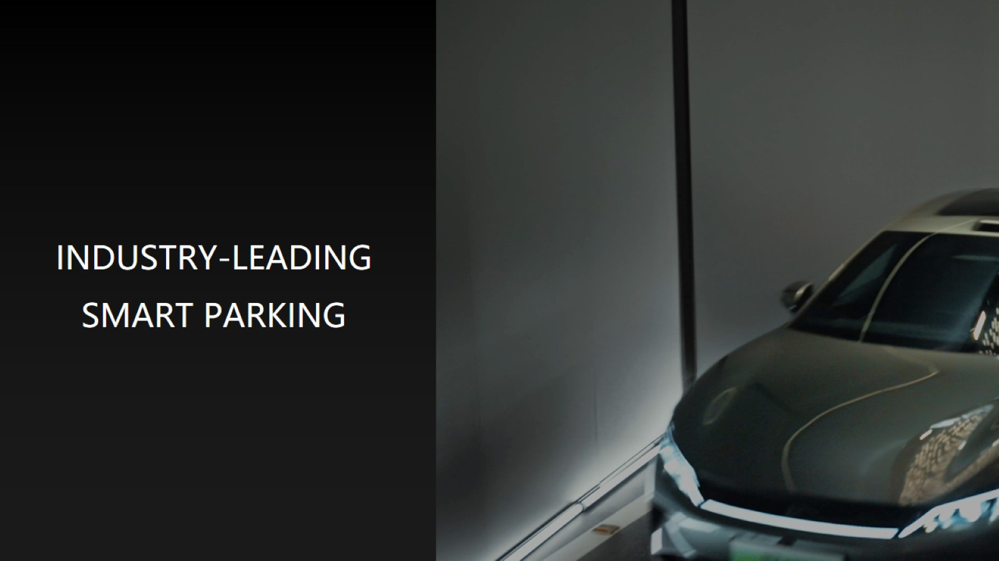

Slide 70
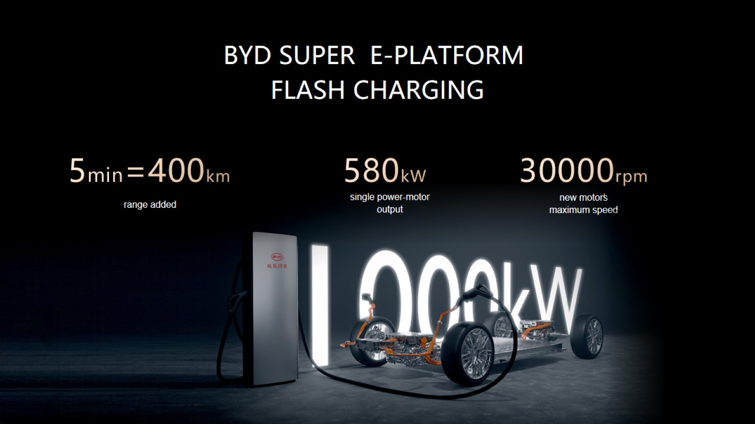

Slide 71
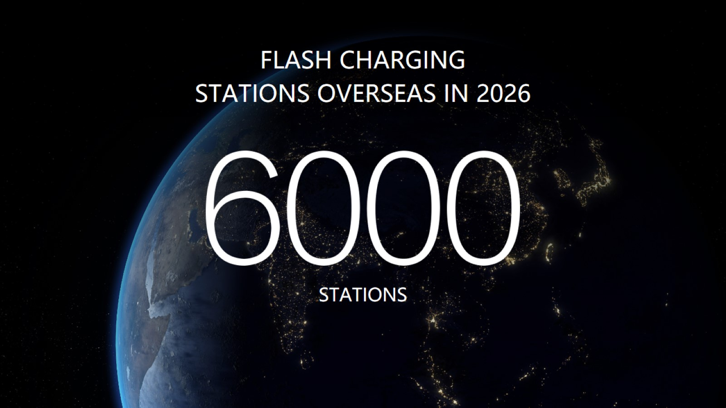

Slide 72


Slide 73


Slide 74
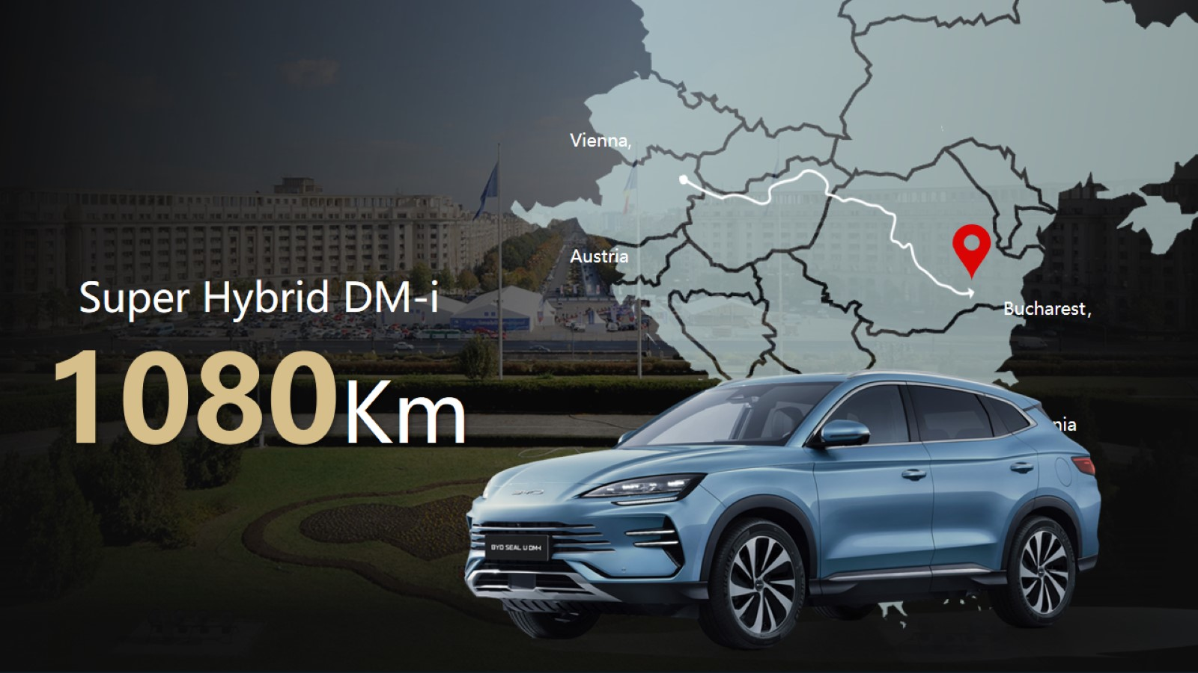

Slide 75
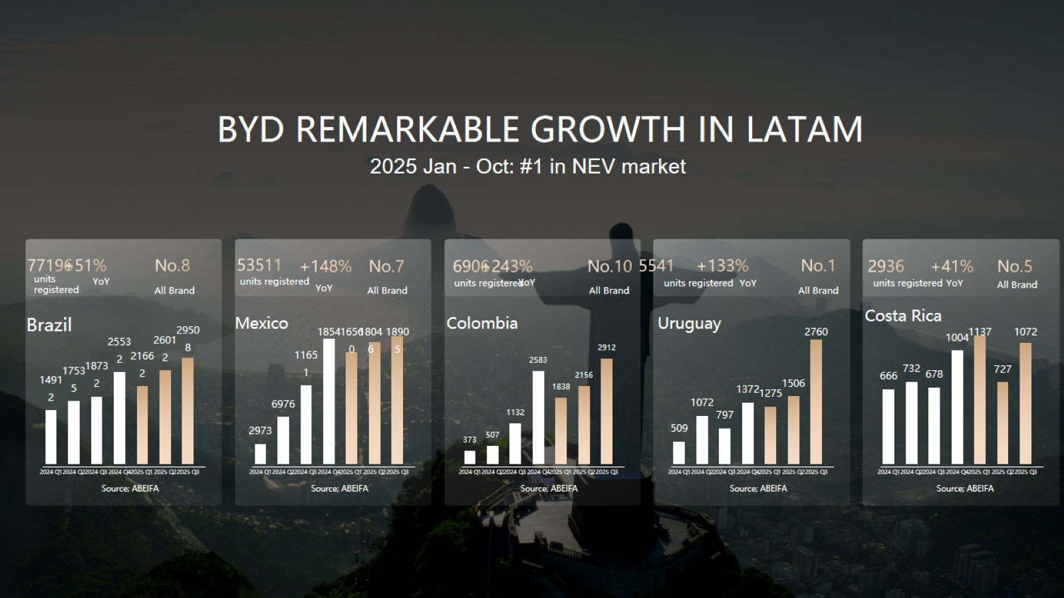

Slide 76
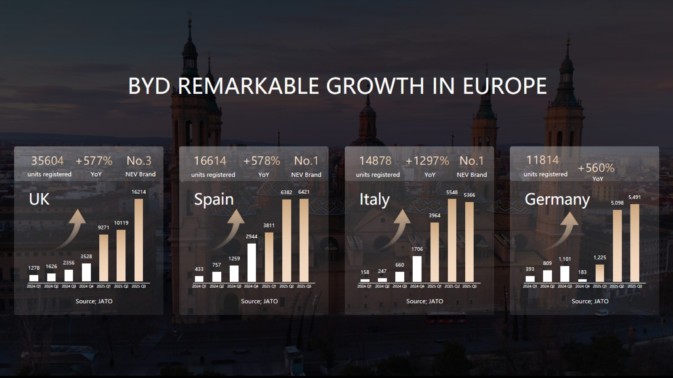

Slide 77


Slide 78


Slide 79


Slide 80


Slide 81


Slide 83


Slide 84

Battery Revolution
Powering Europes Transition through Innovation and Sustainability

Slide 85


Slide 86


Slide 87

Products & Technology

Slide 88

Made for Europe

Slide 89

Products & Technology

Slide 90


Slide 91


Slide 92


Slide 93


Slide 94

CATL Solutions - Building Zero-carbon Ecology

Slide 96


Slide 97

From Inventor of Diesel to a Pioneer of Zero Emission

Slide 98


Slide 99

OUR PRIME PATH: BEV FIRST, BUT NOT ONLY!

Slide 100

Future starts now: we cover already 60% of use cases

Slide 101

Our full range ELECTRIC product portfolio

Slide 102

FURTHER ADVANTAGES OF ELECTRIC TRUCKS FOR CUSTOMERS

Slide 103

Success in decarbonization: multiplication of the factors

Slide 104

INFRASTRUCTURE IS A CHALLENGE AND A TASK FOR EVERYONE!

Slide 105

KEY TAKEAWAYS

Slide 107


Slide 108


Slide 109


Slide 110


Slide 111


Slide 112


Slide 113


Slide 114


Slide 115


Slide 116


Slide 117


Slide 118


Slide 119


Slide 121


Slide 123


Slide 124


Slide 125


Slide 126


Slide 127


Slide 128


Slide 129


Slide 130


Slide 131


Slide 132


Slide 134


Slide 135


Slide 136

New. Independent. Global
+125 years heritage

Slide 137

Positioned for global leadership

Slide 138

Global scale

Slide 139

Horse Powertrain in Romania

Slide 140

System overview
Horse One combustion engines and transmissions

Slide 141

System overview
Horse Fusion hybrid engines and transmissions

Slide 142

System overview
Horse X-Range powertrains for dedicated EV platforms

Slide 143

HORSE H12 GPL
Next-generation 1.2-liter GPL

Slide 144

HORSE C15
Ultra compact range extender

Slide 145

HORSE 4DHT120
Hybrid transmission system

Slide 146

Our roadmap for disruptive innovation

Slide 147


Slide 148


Slide 149

Thank you

Slide 151


Slide 152


Slide 153

IS ROMANIA READY FOR GREEN ENERGY AND ELECTRIC MOBILITY?

Slide 154


Slide 155


Slide 156


Slide 157


Slide 158


Slide 159


Slide 161


Slide 162


Slide 163


Slide 164


Slide 165


Slide 166

Have We Reached “Peak Car”?

Slide 167

Global Market Growth Shifts East

Slide 168

Private Transport Still Dominates

Slide 169

The Consumer Dilemma: Cost vs. Climate

Slide 170

BEVs are the Undisputed Efficiency Leaders

Slide 171

E-Fuels: A Drop in the Ocean for Niche Sectors

Slide 172

The Chinese EV Market

Slide 173

The Elephant in the Room: Energy Density

Slide 174

Battery Energy Density is Steadily Rising

Slide 175

Solid-State Technology Makes the 1000km Range Reality

Slide 176

Bridging the Gap from Tech to Adoption

Slide 177

REEVs as the Intelligent Bridge

Slide 178

Affordable E-Mobility Starts With Two Wheels

Slide 179

Beyond the Tailpipe – the Zero Waste Imperative

Slide 180

Sustainability Mindset

Slide 181


Slide 182

Autonomy: From Vision to Proven Reality

Slide 183

Networking Vehicles to Each Other and with the Infrastructure (V2X) will Provide the Next Level of Safety...

Slide 184

And will Allow to Open Up Our Cities

Slide 185

A New Human Experience

Slide 186

The Great Autonomy Disruption

Slide 187

From Disruption to Action: US Tech Leads the Way

Slide 188


Slide 189

The New Global Battleground

Slide 190


